Slide 1
ADSA PROJECT
GROUP 9
Yeshwanth V 106119147
R.Aravinth 106119101
Thavpalan Arivan 106119135

Slide 2
Data Strucutres
Treaps
K-ary Heap
Fibonaci Heap

Slide 3
K-ary Heap
A complete tree where every node has a key value and each node can have maximum of k number of children.
Parent node is always greater or less than it’s children which depends whether heap is max or min heap.

Slide 4
Min K-ary heap with k=3
12
19
25
13
22
24
20

Slide 5
Insertion
Insert the element at n+1 index(n=last index)
Check with it's parent for heap property
If not satisfied swap with it's parent
Go to Step 2 and do till heap property gets satisfied.

Slide 6
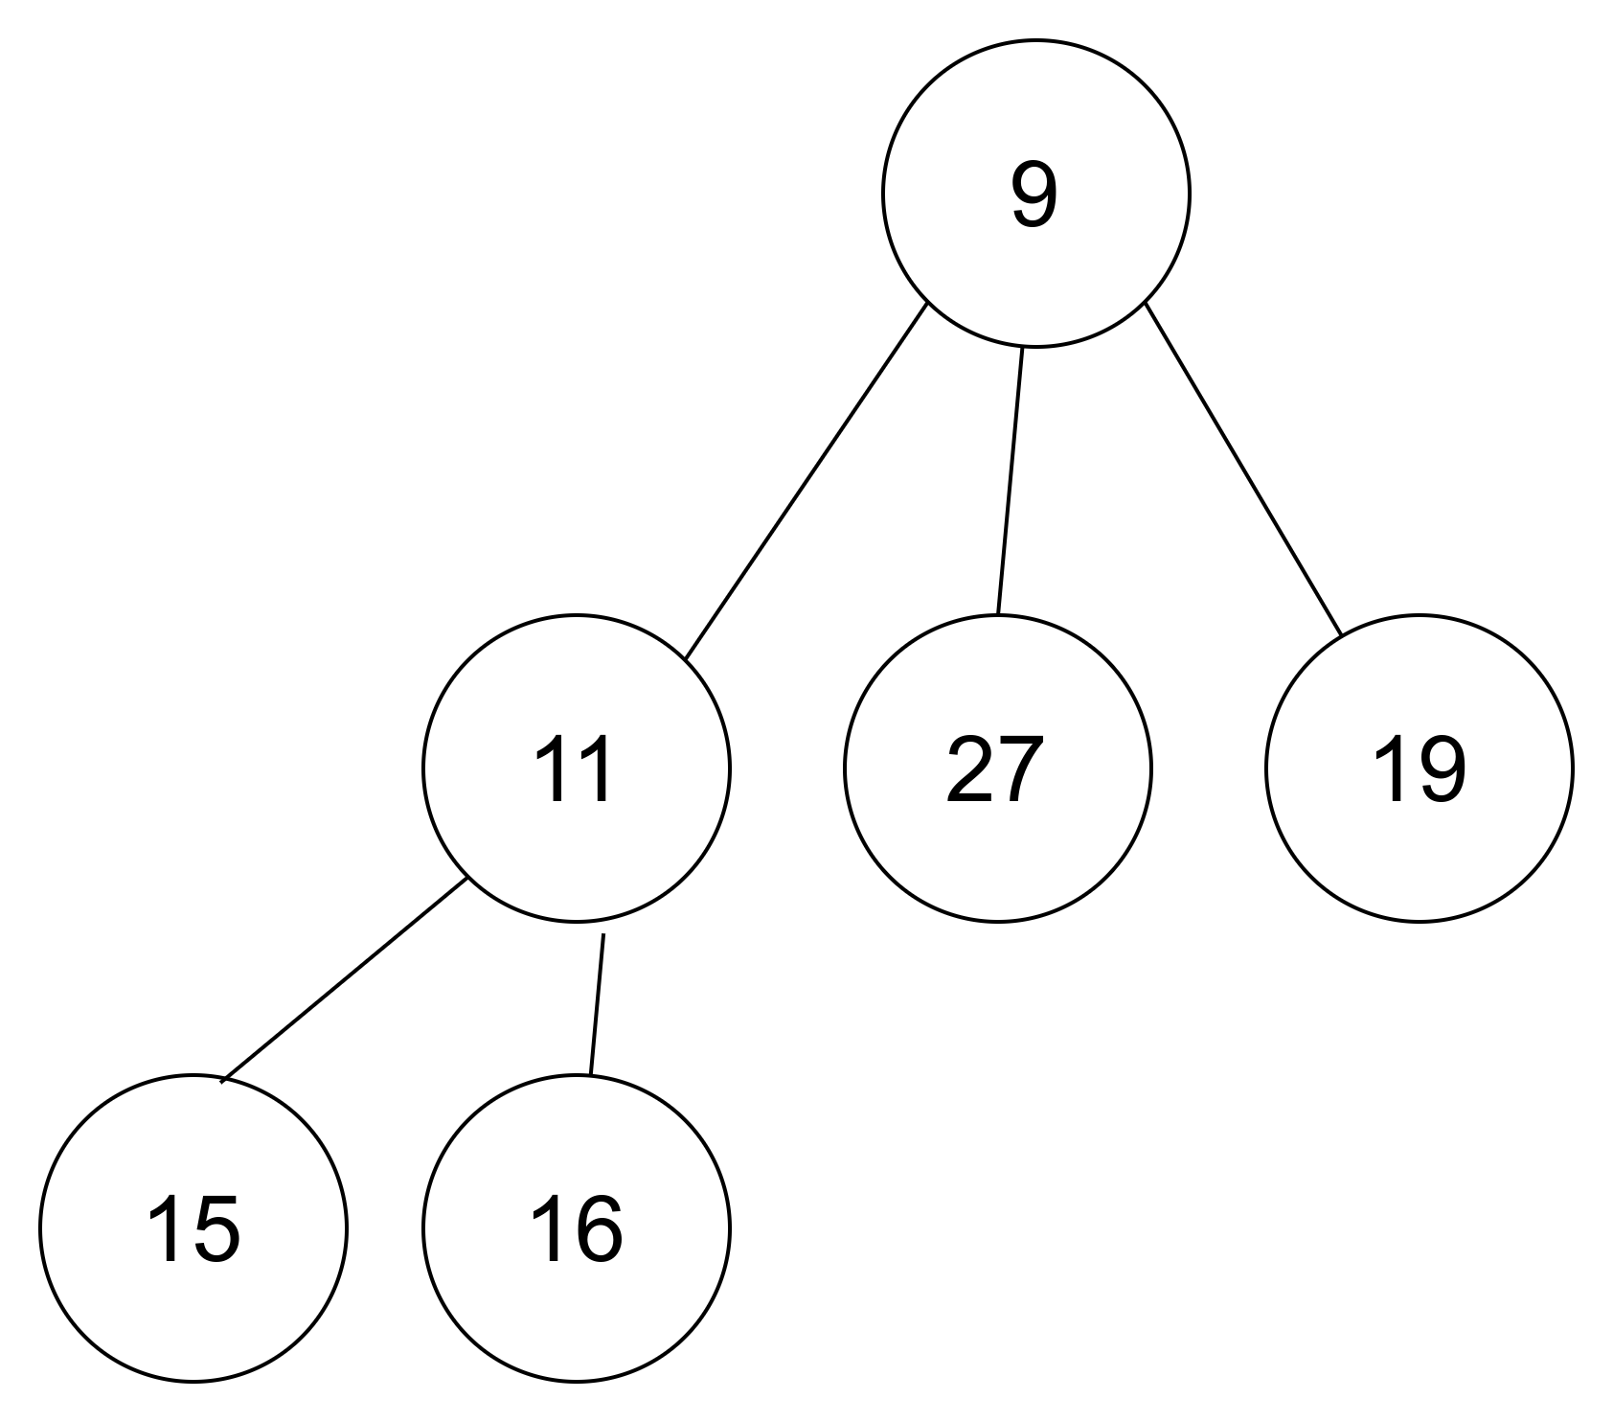
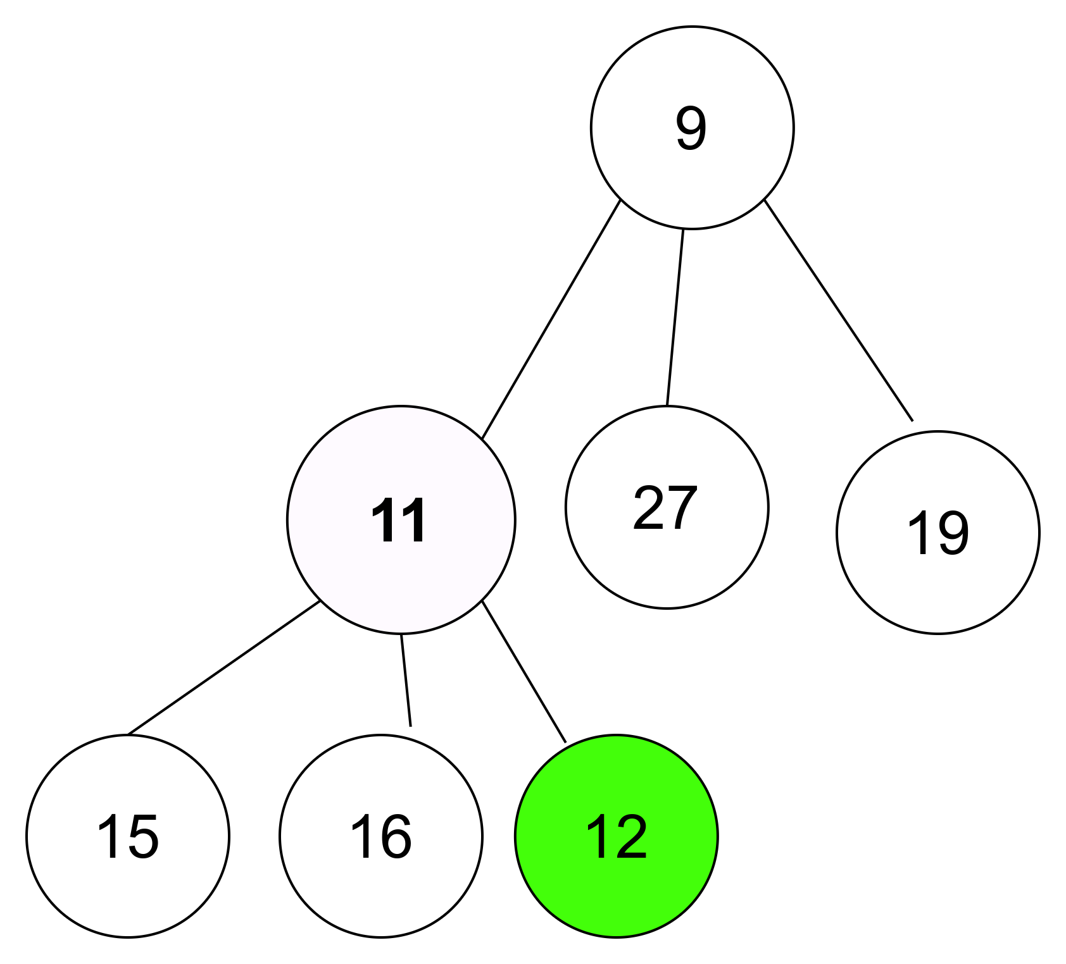
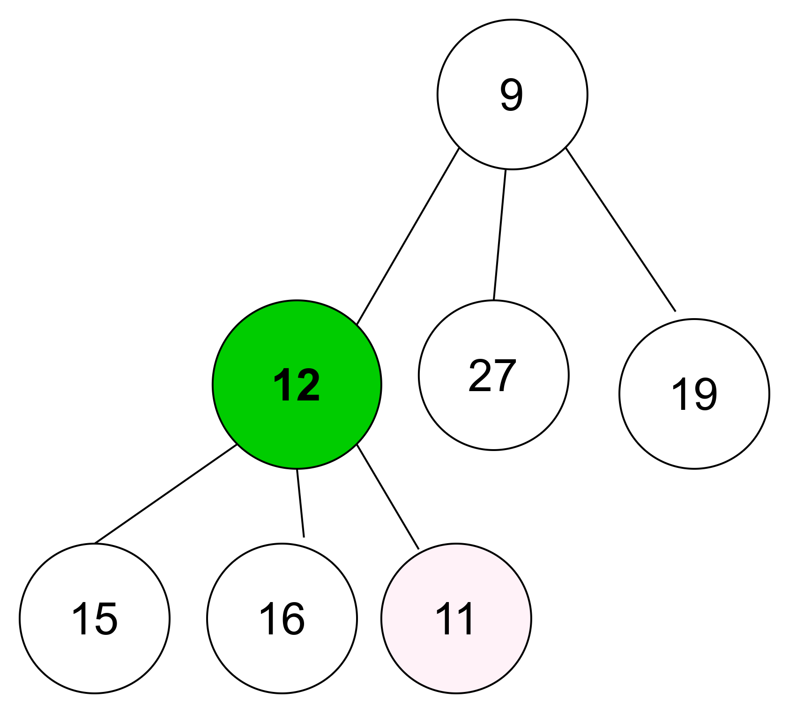
INSERT 12

Slide 7
Deletion
Search the given key value in the heap
If key is found swap it with root key
Swap Root with last index key
Decrement size by one. Pointer to root
Find the minimum children key
If minimum key less than parent, then swap
Repeat step 5 until heap property satisfied

Slide 8
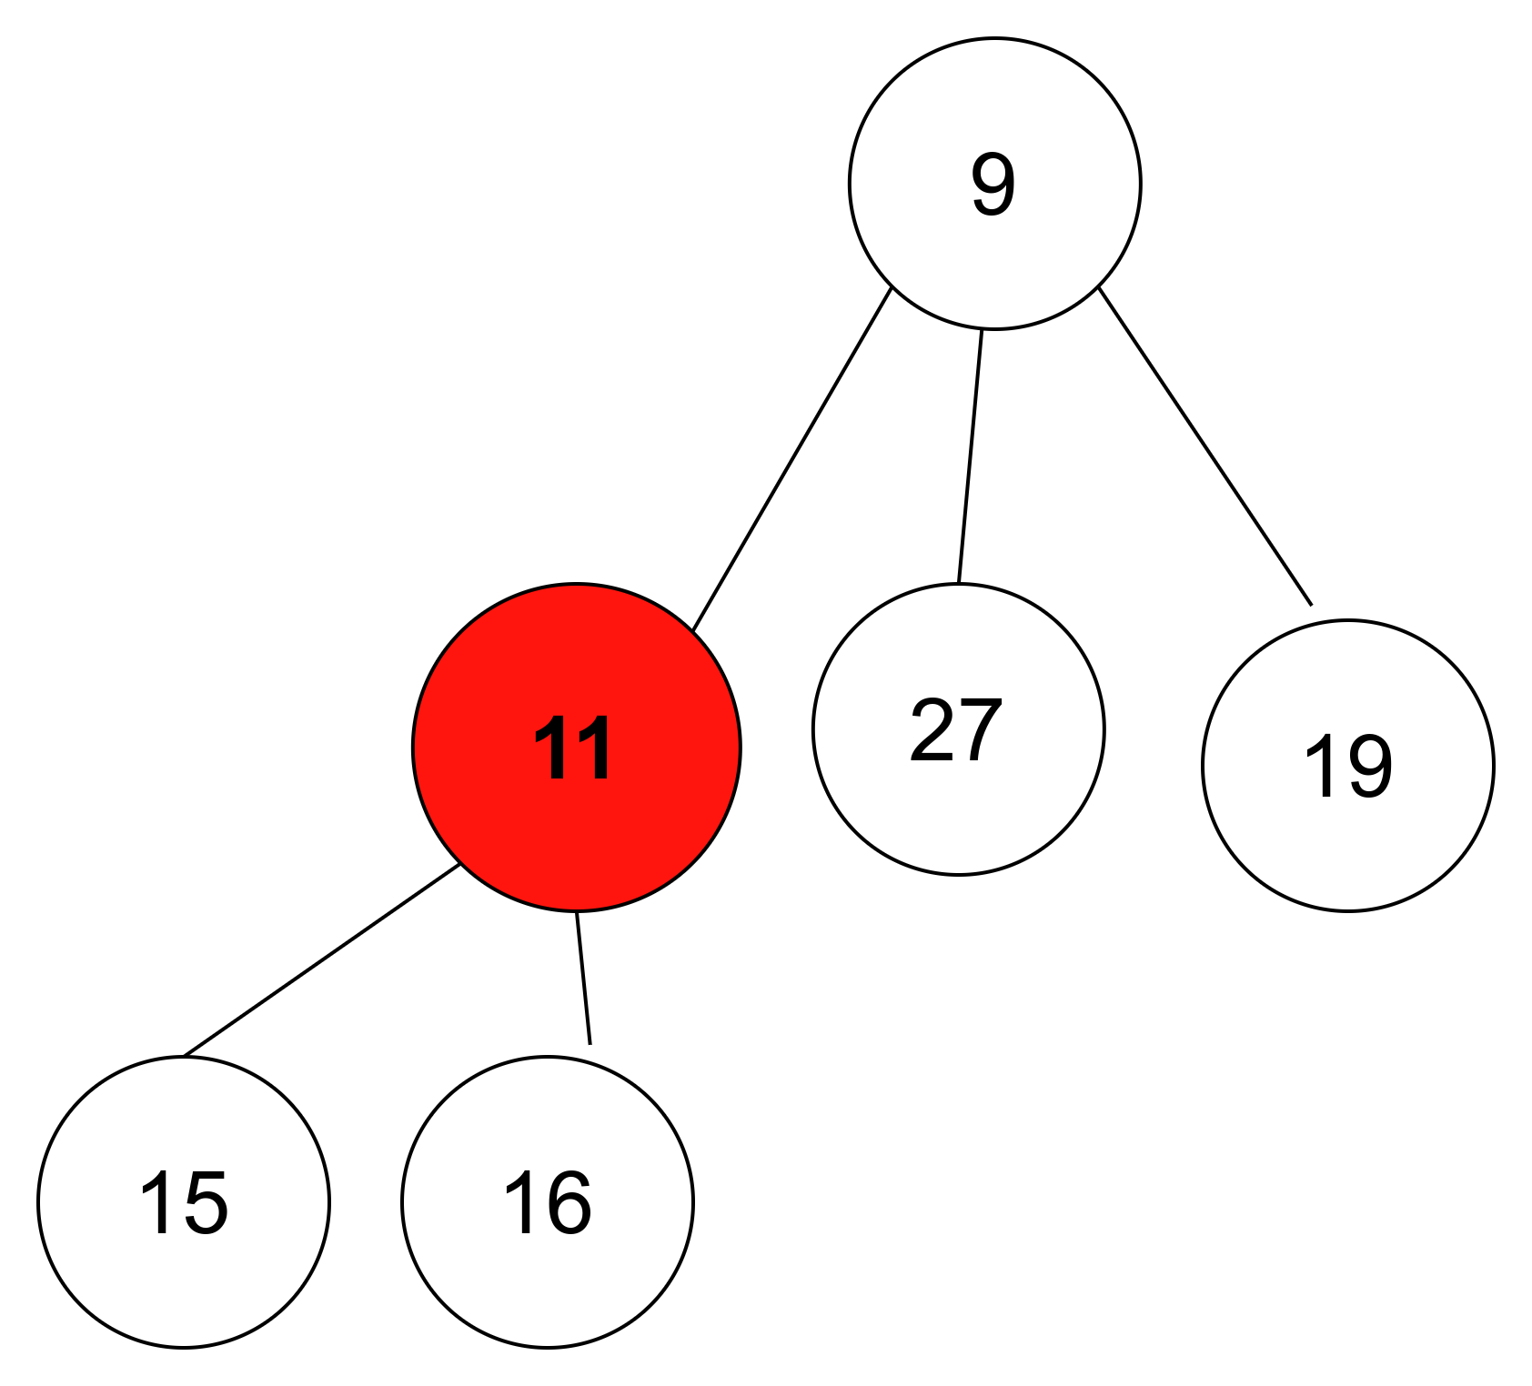
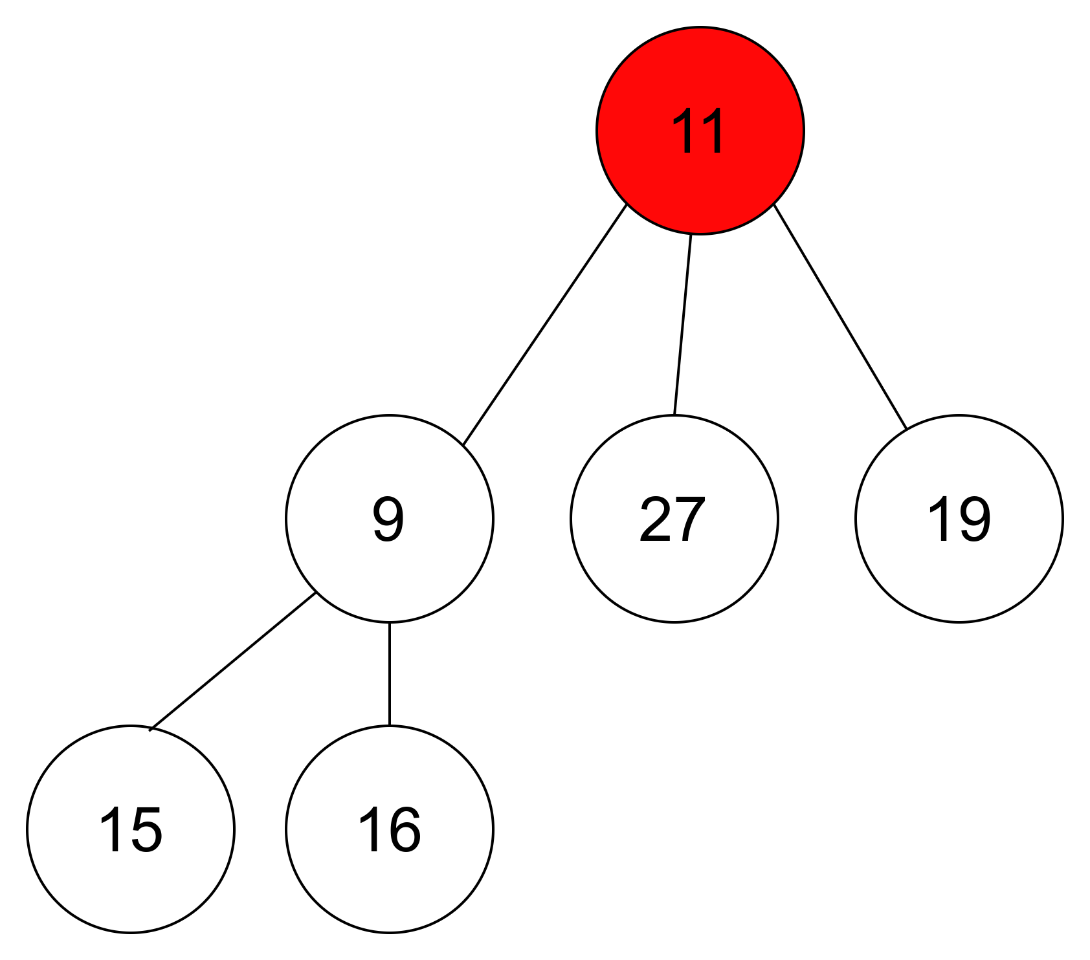
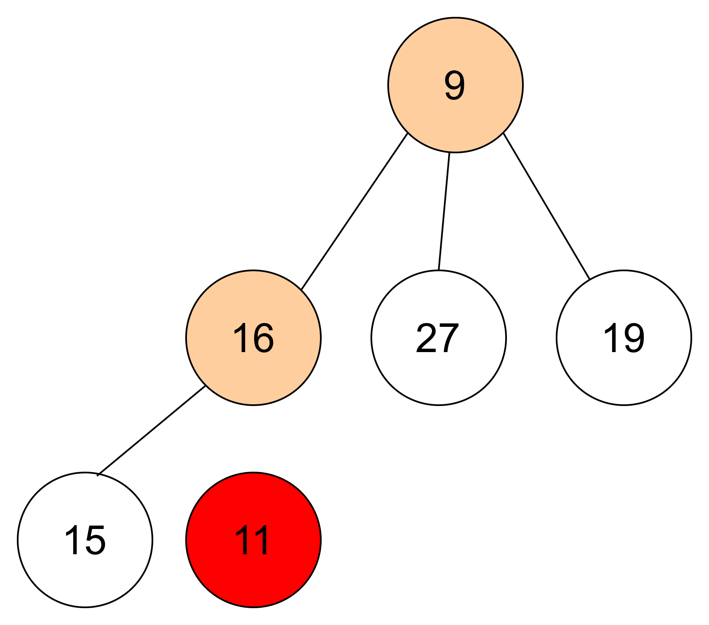
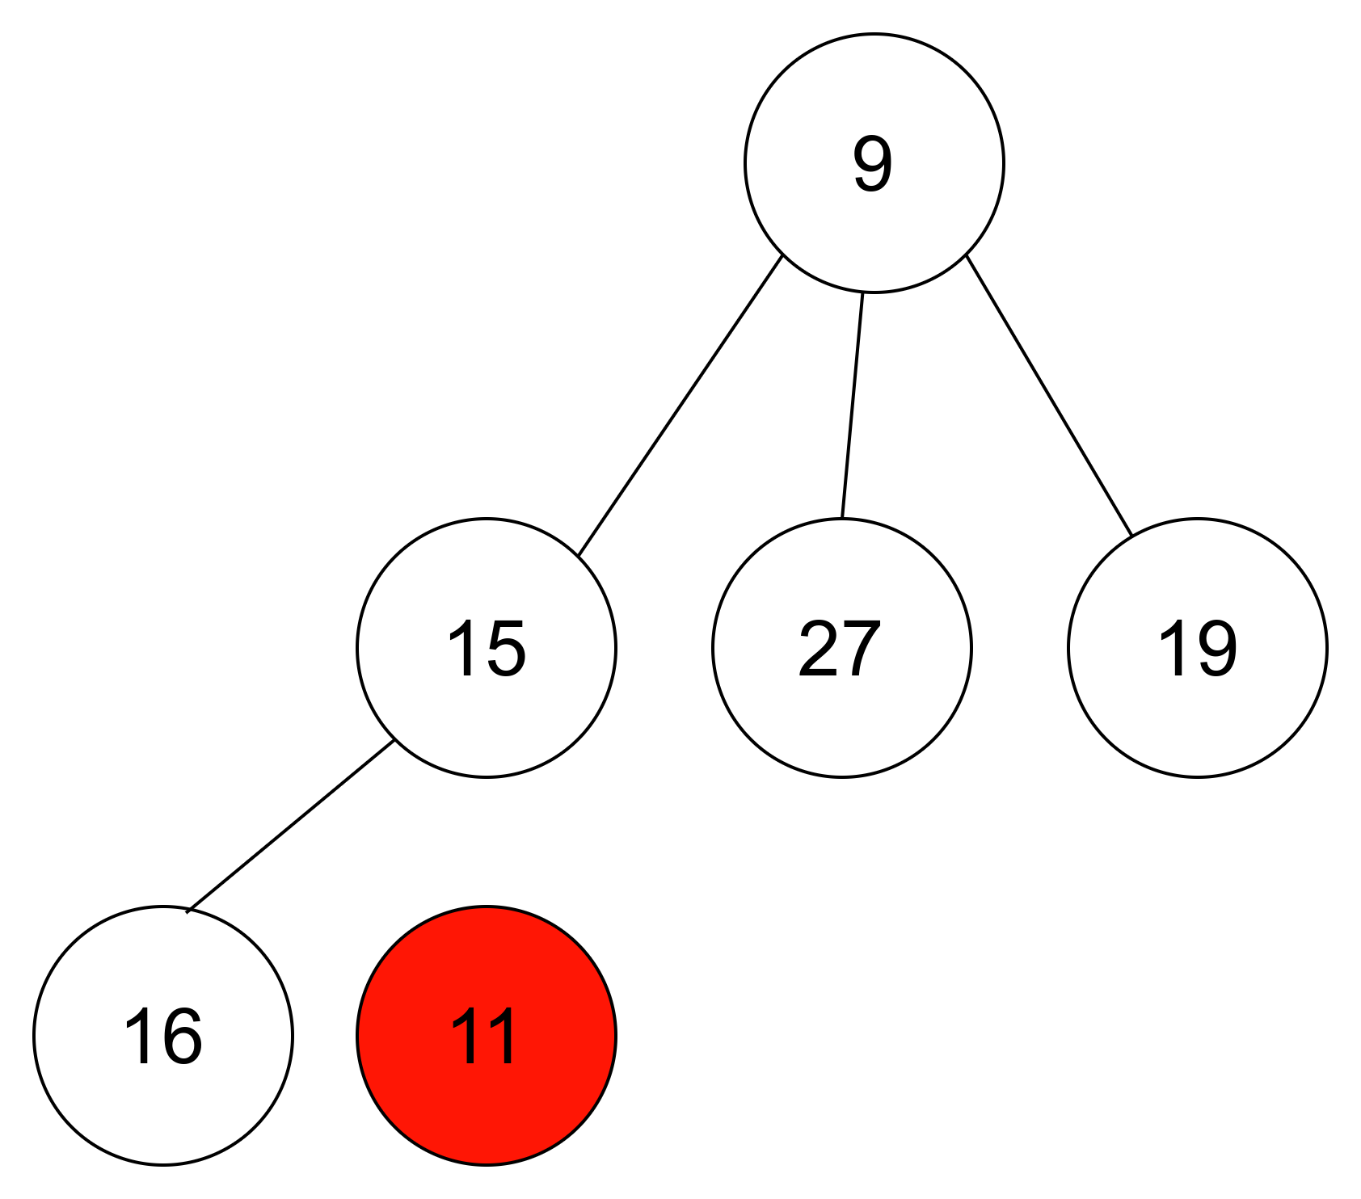

DELETE 11

Slide 9
Search
Traverse through each level of the heap.
If key is found return index
Else return -1

Slide 10
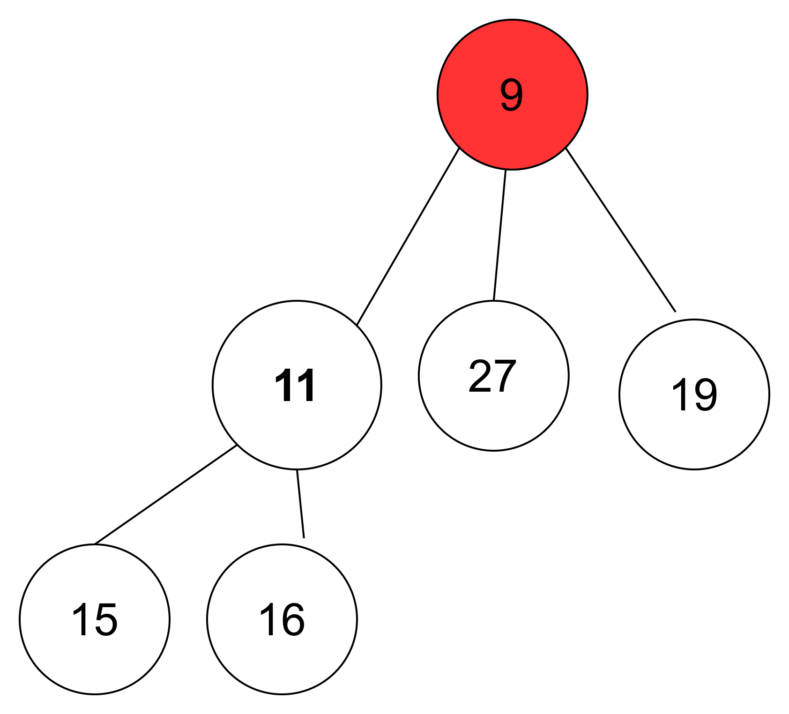
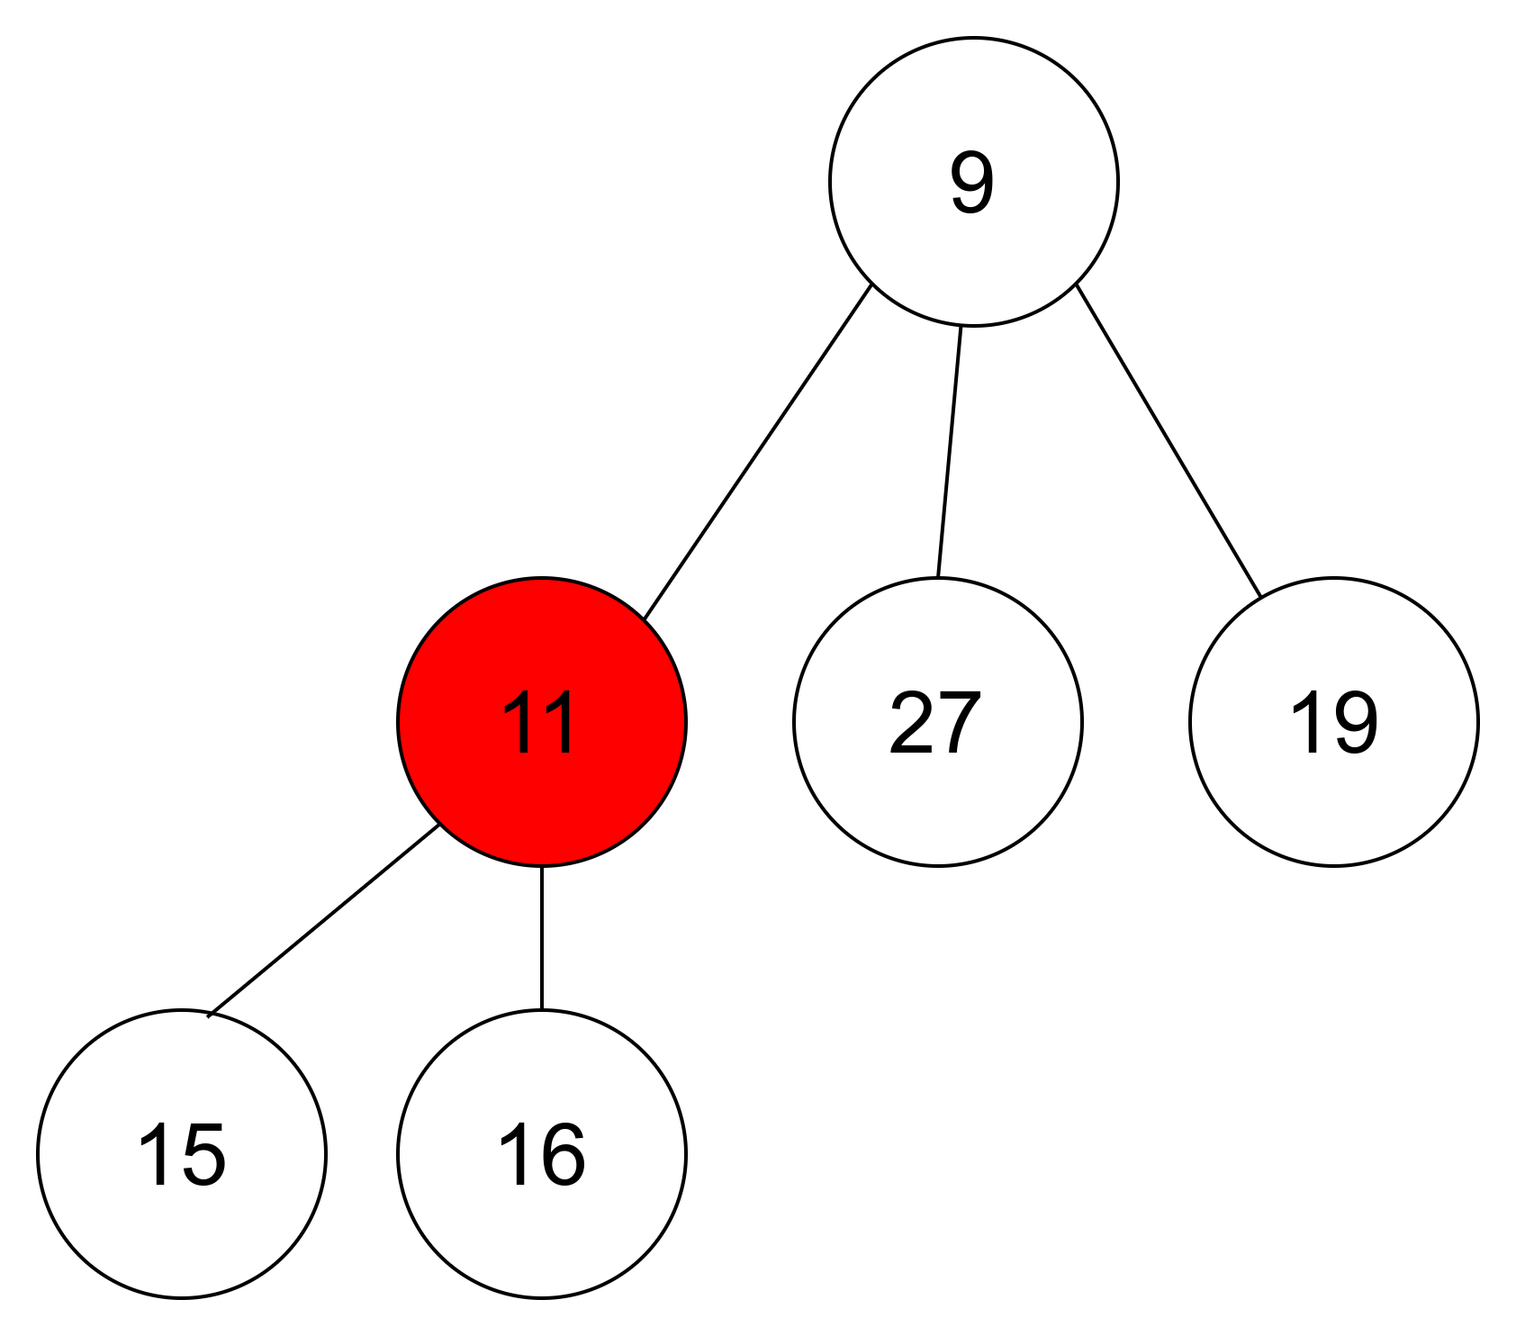
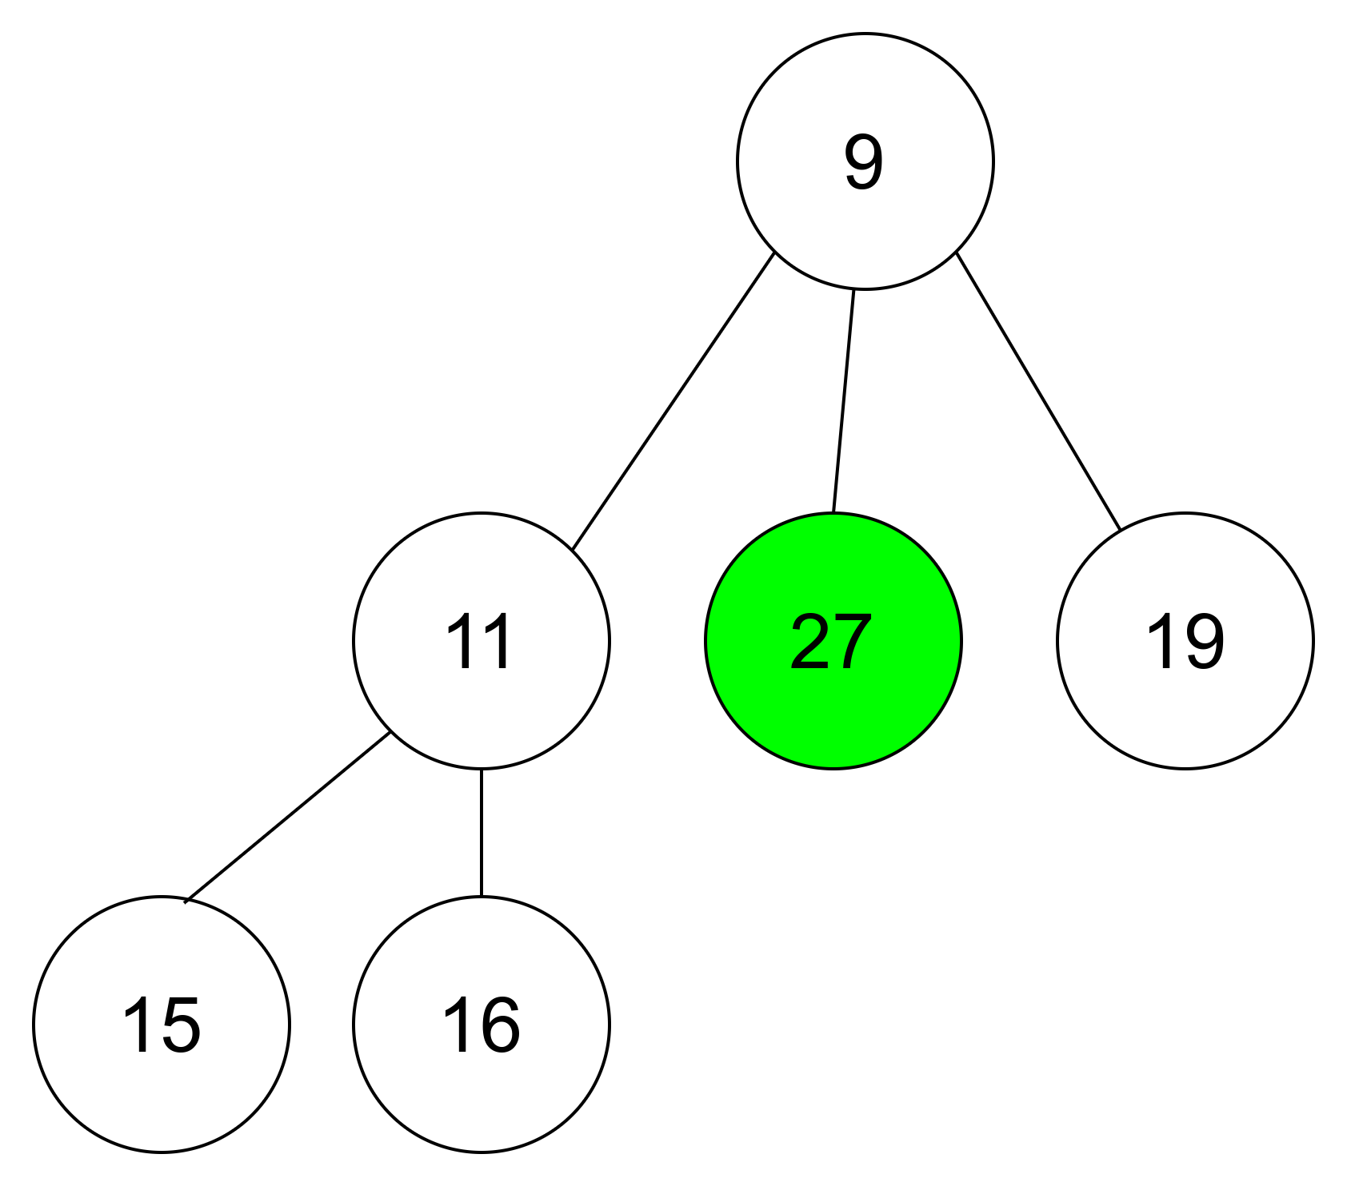
SEARCH 27

Slide 11
Find Minimum
If the k-ary heap is min heap root will be minimum key
If the k-ary heap is max heap root key will be maximum key

Slide 13
Extract Minimum
Swap Root with last index key
Decrement size by one. Pointer to root
Find the minimum children key
If minimum key less than parent, then swap
Repeat step 3 until heap property satisfied

Slide 14
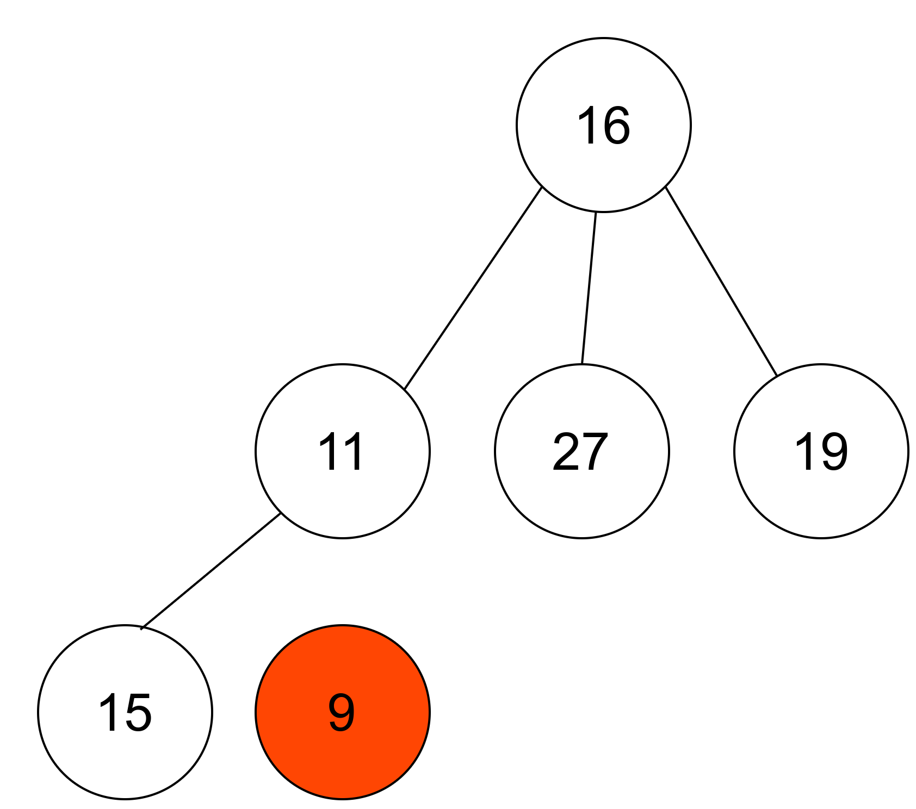

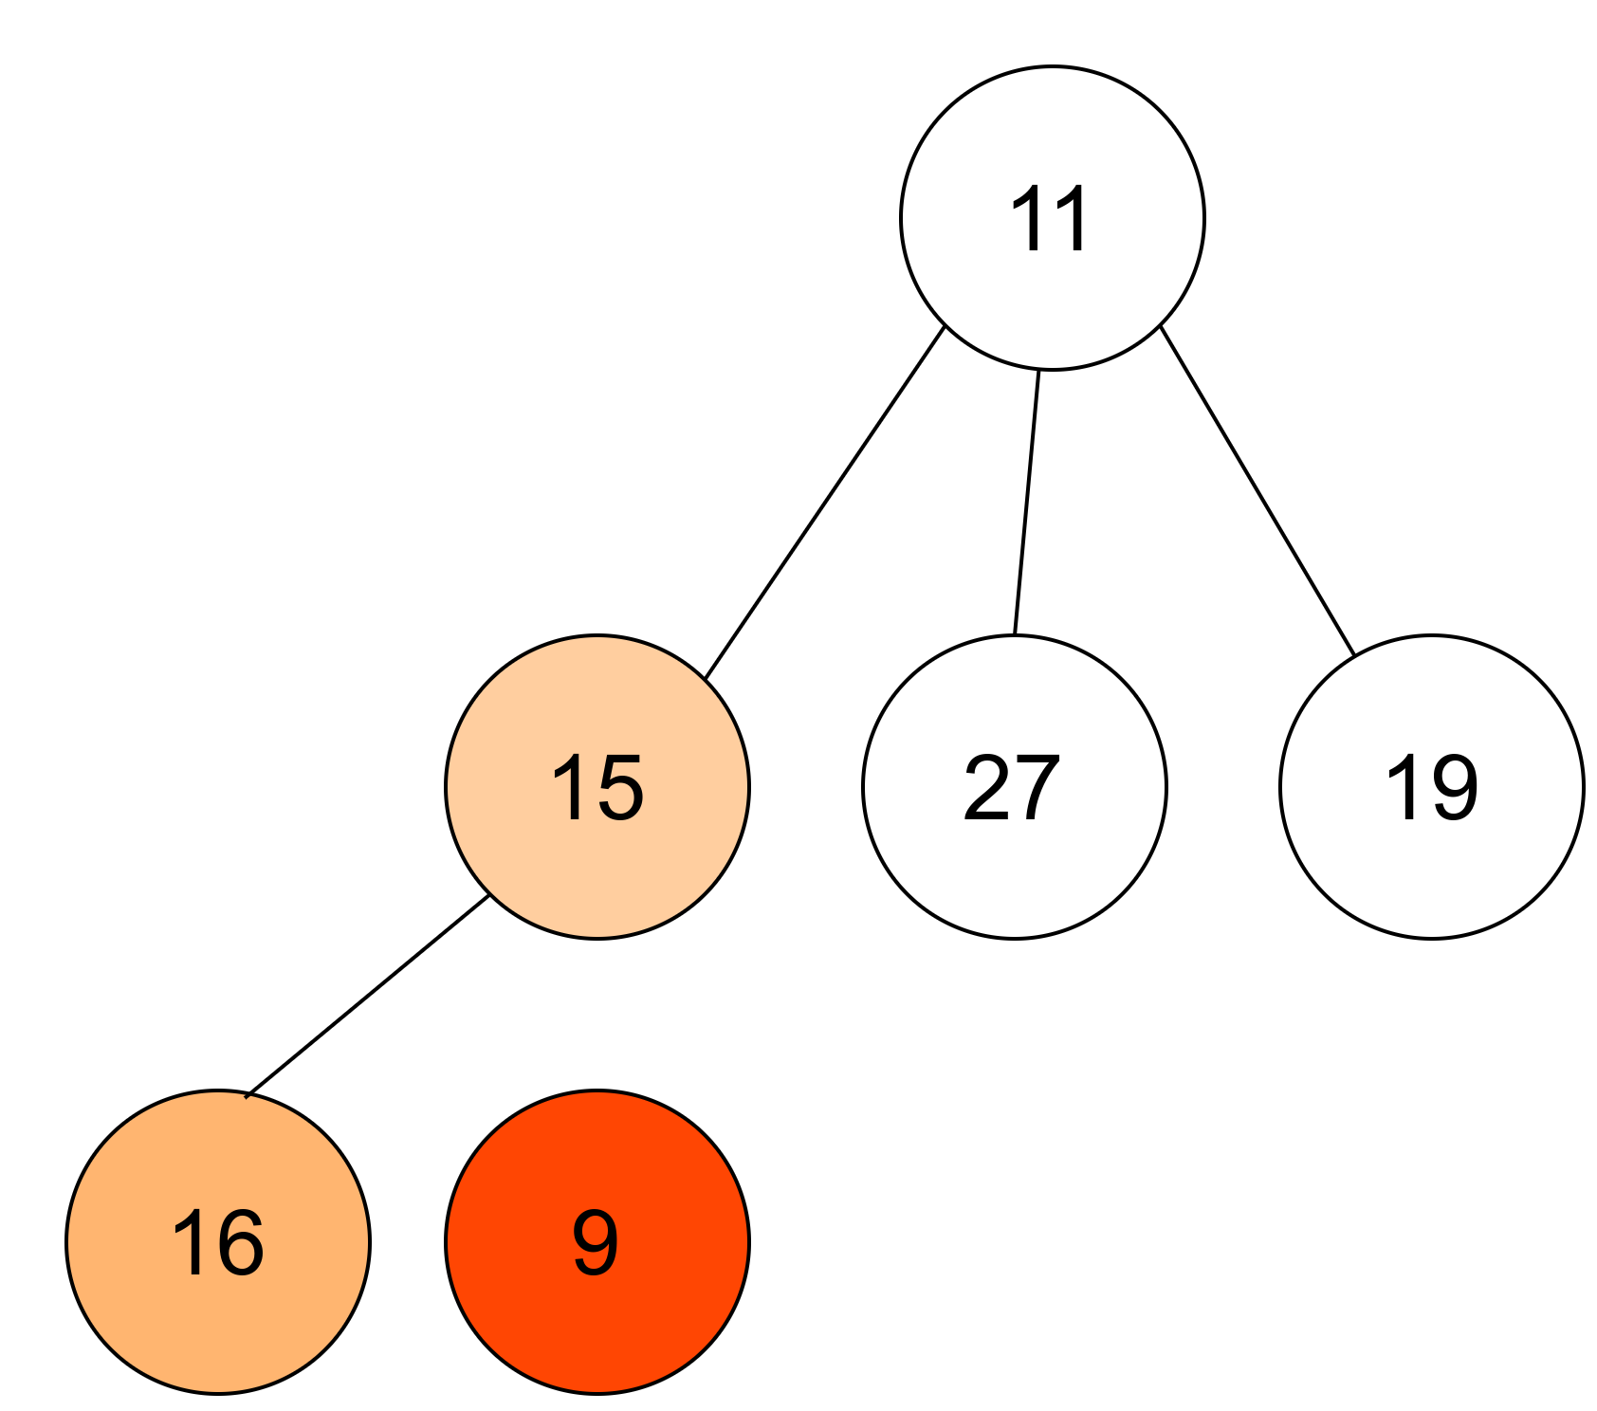

Slide 15
Treap
Treap is a Balanced Binary Search Tree
The idea is to use Randomization and Binary Heap property to maintain balance with high probability.
Every node of Treap maintains two values.
Key value follows tree property
Priority value follows Max-heap Property

Slide 16
Treap
40
12
32
8
45
10
19
4
35
6

Slide 17
Insertion
Create node with key value and randomized priority value.
Insert node based on key value as per standard BST insertion
Perform Rotations to make sure the heap property is satisfied based on the priority value.

Slide 18
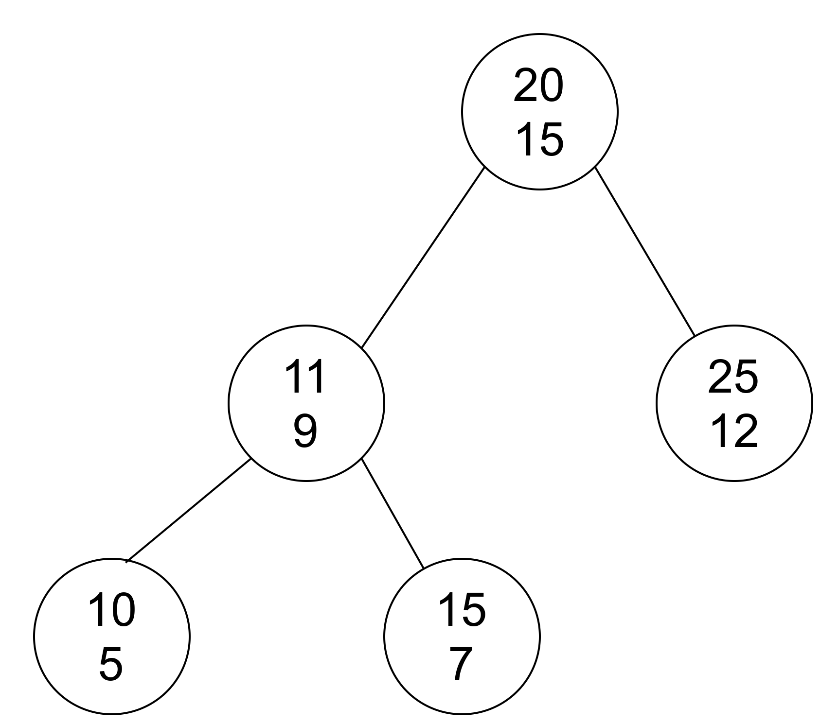
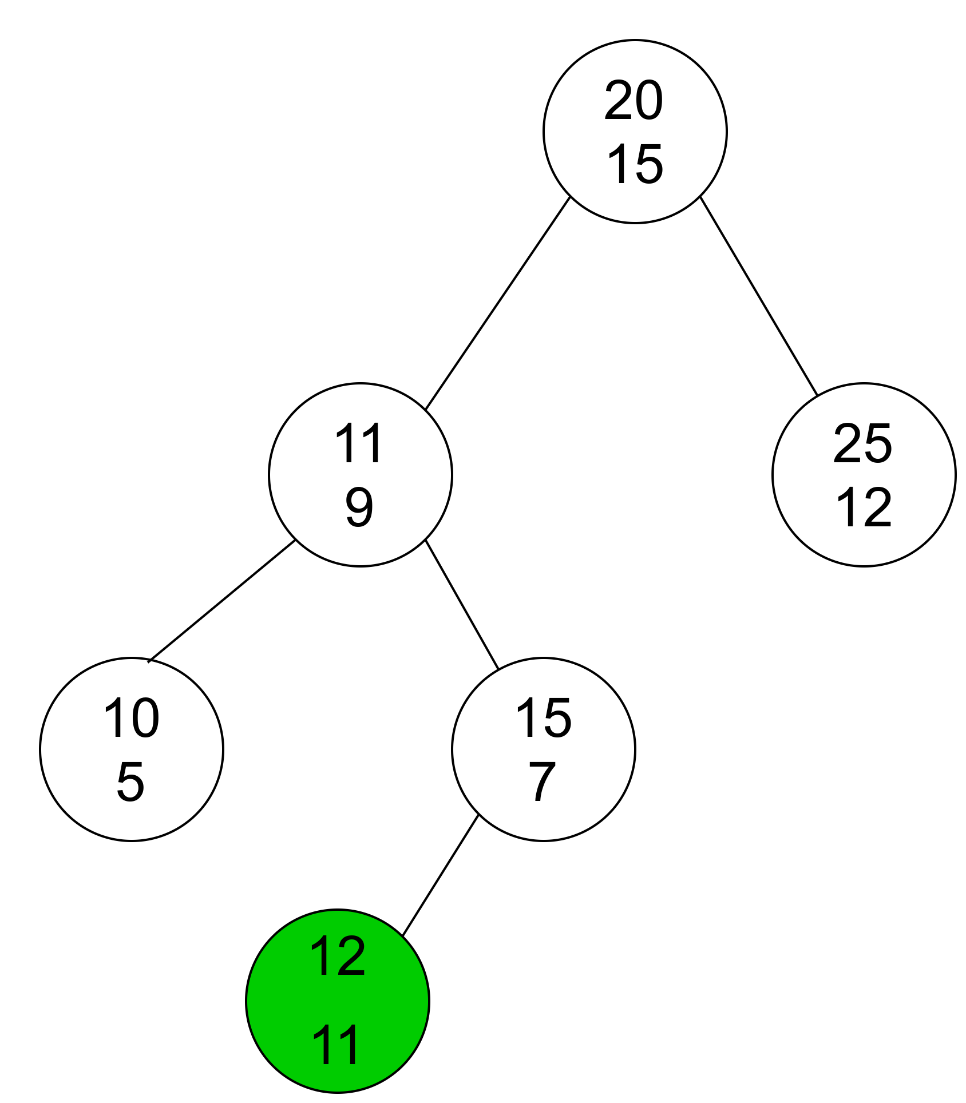
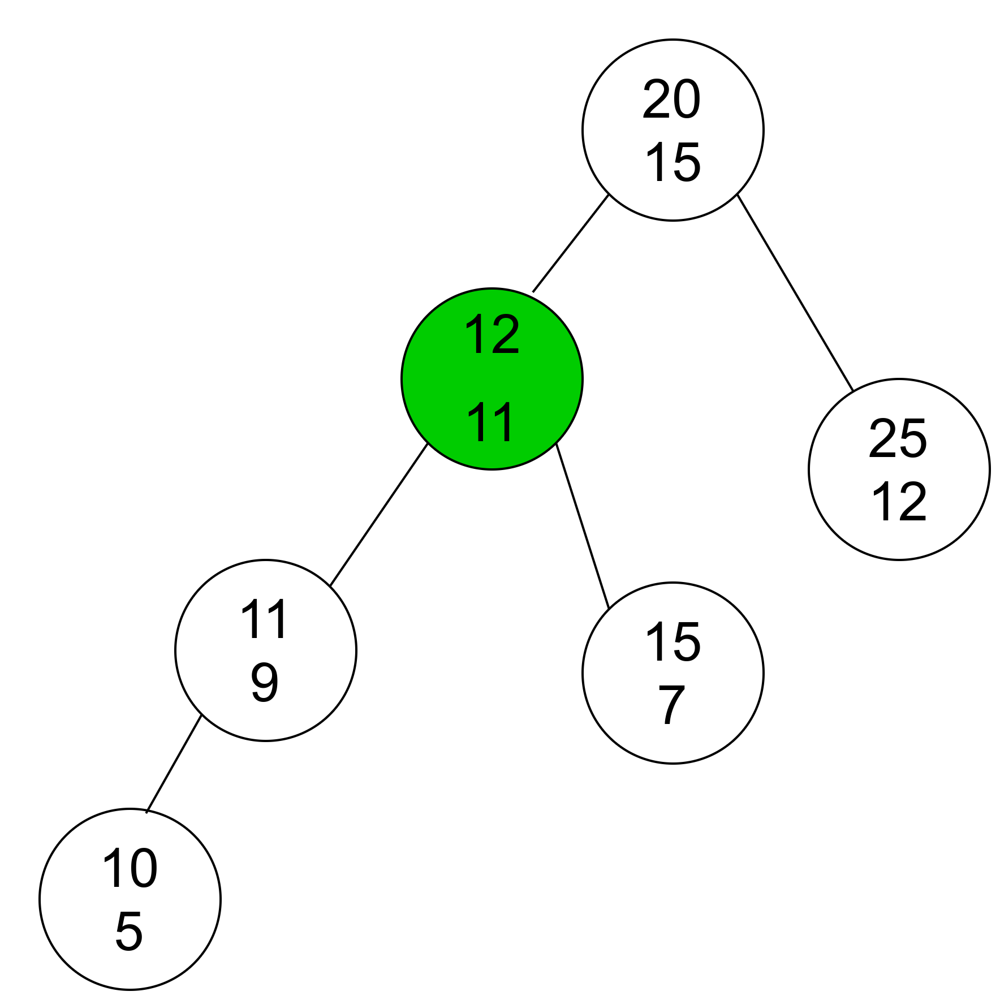
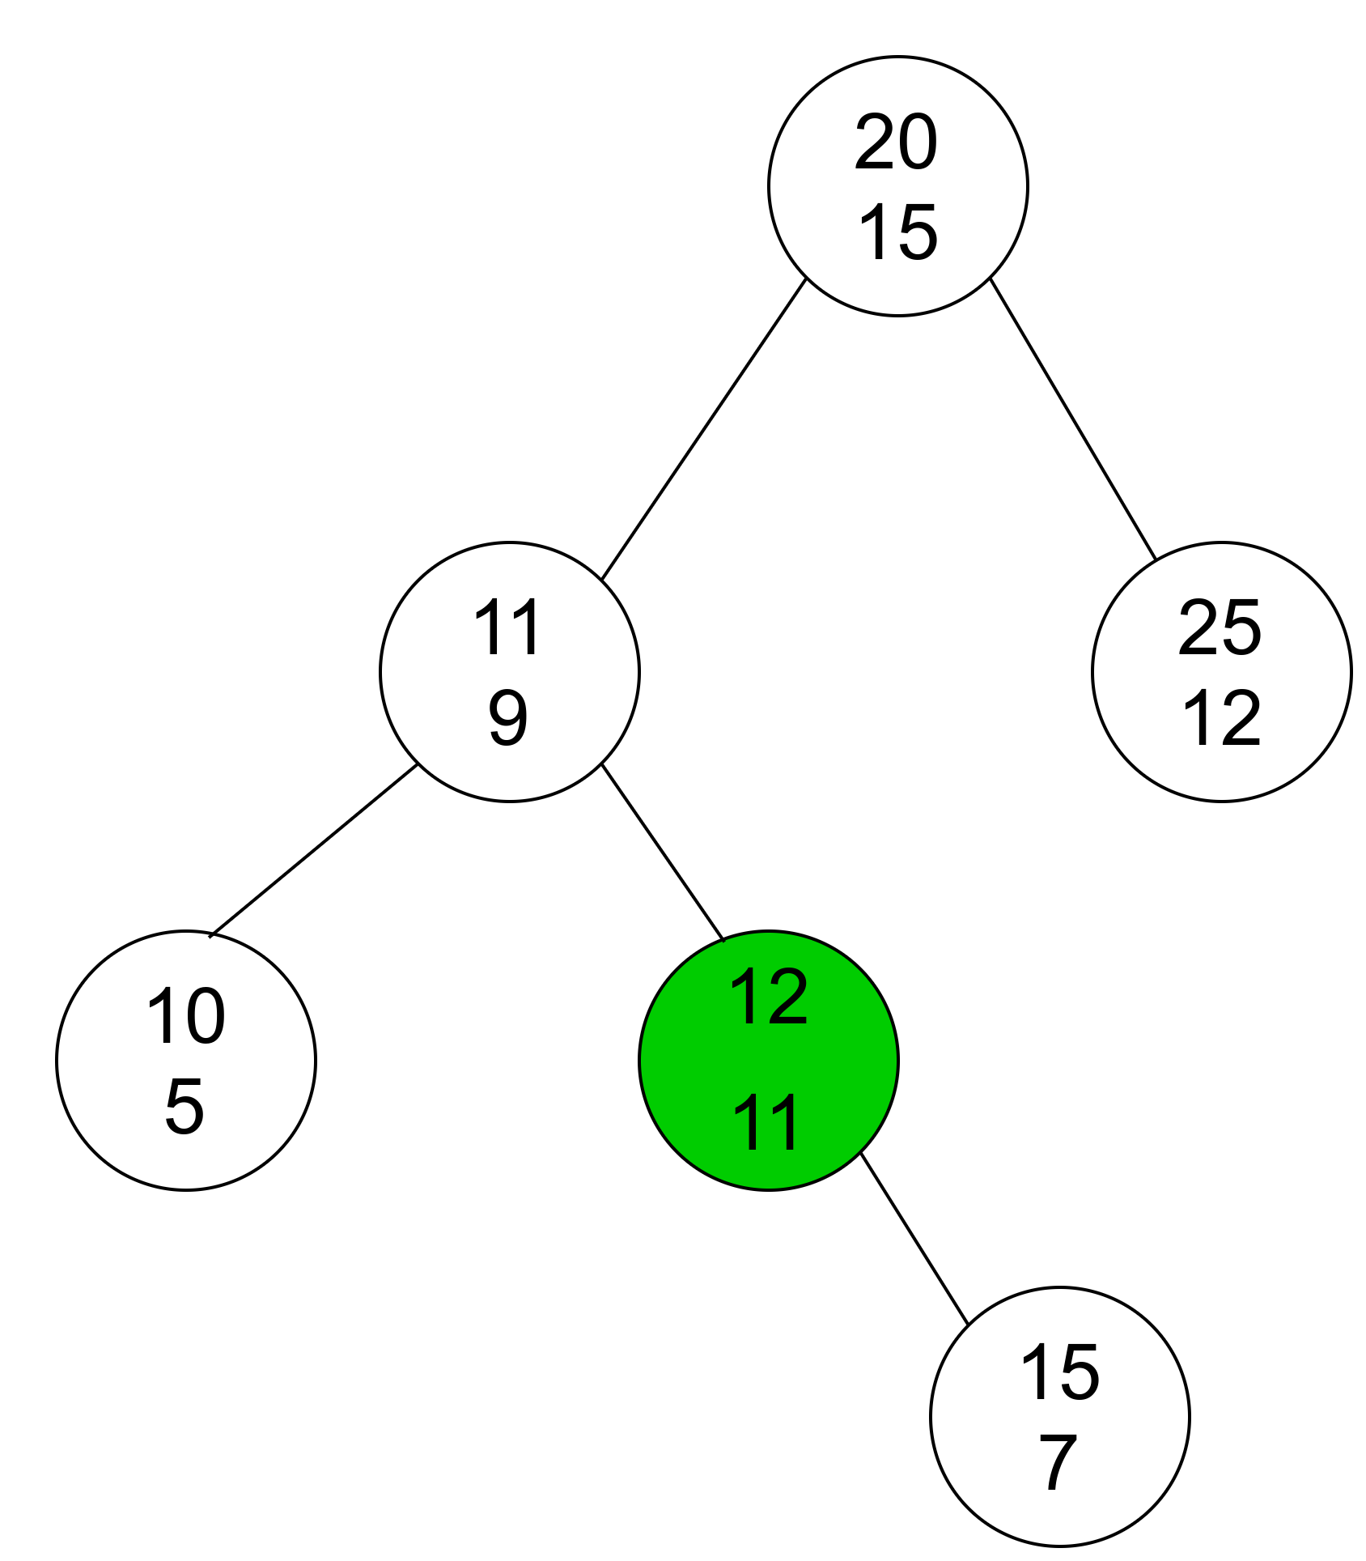
INSERT 12

Slide 19
Deletion
Search for the given node.
If the key is found at leave node, delete the node.
If node has only one child replace node by it child
If both two children are non-null , find max of children.
If priority of right child is greater, left rotate.
If priority of left child is greater, right rotate.

Slide 20
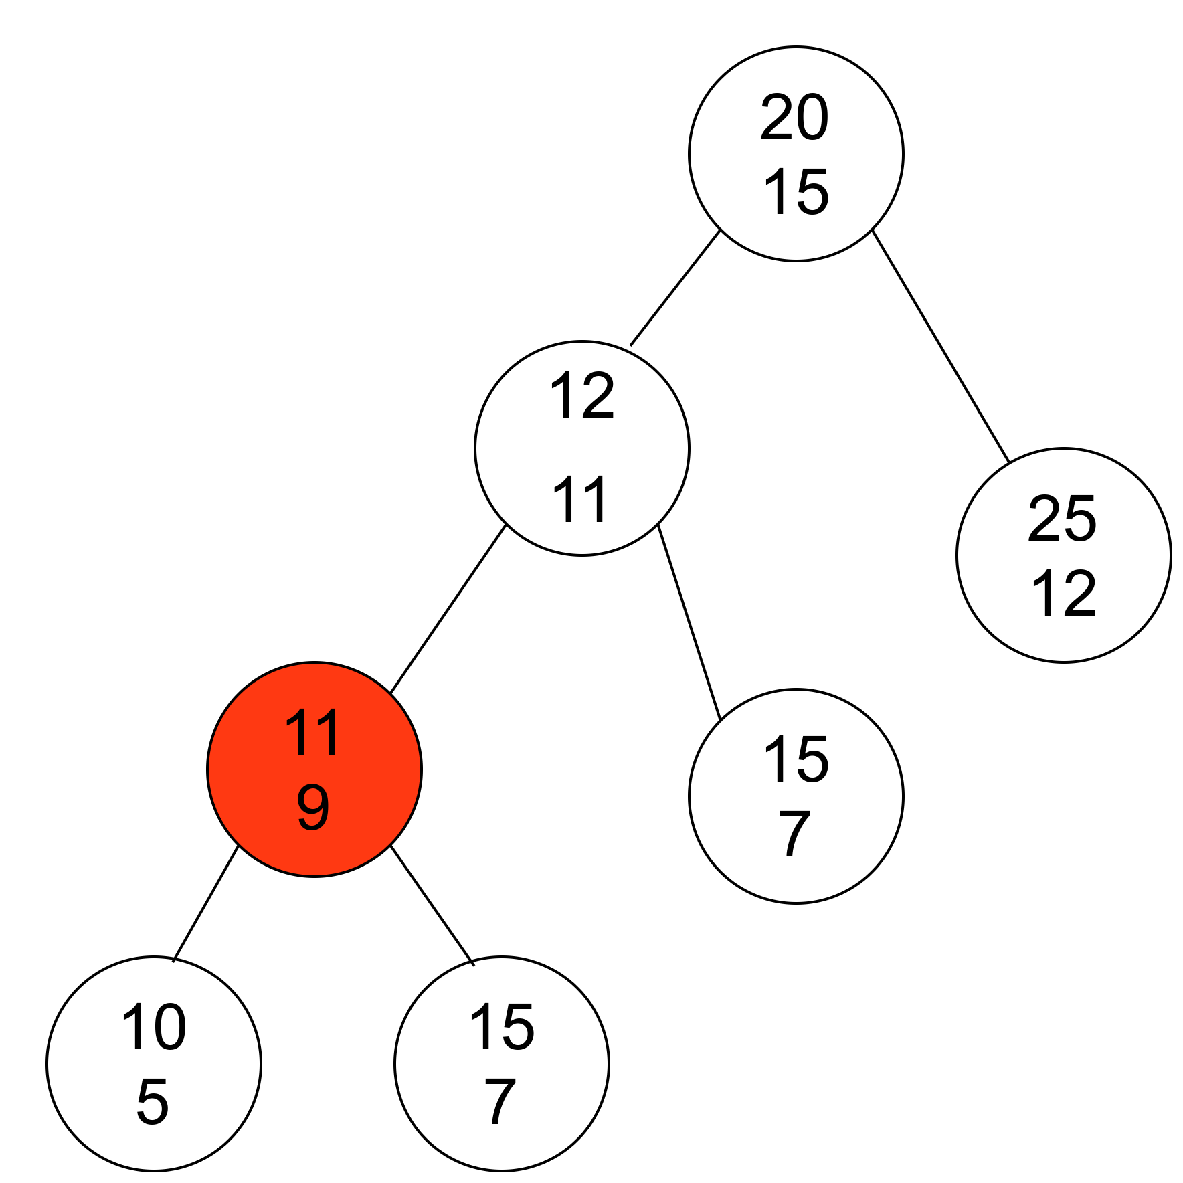
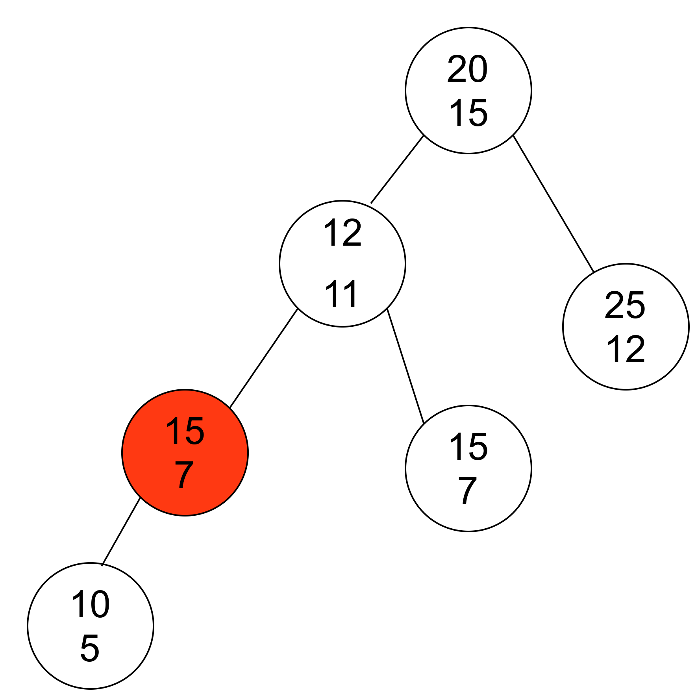
DELETE 11

Slide 21
Search
Pointer to root
If search key less than pointer to left child.
Else pointer to right child.
Repeat step 2 till pointer not equals to null.

Slide 22
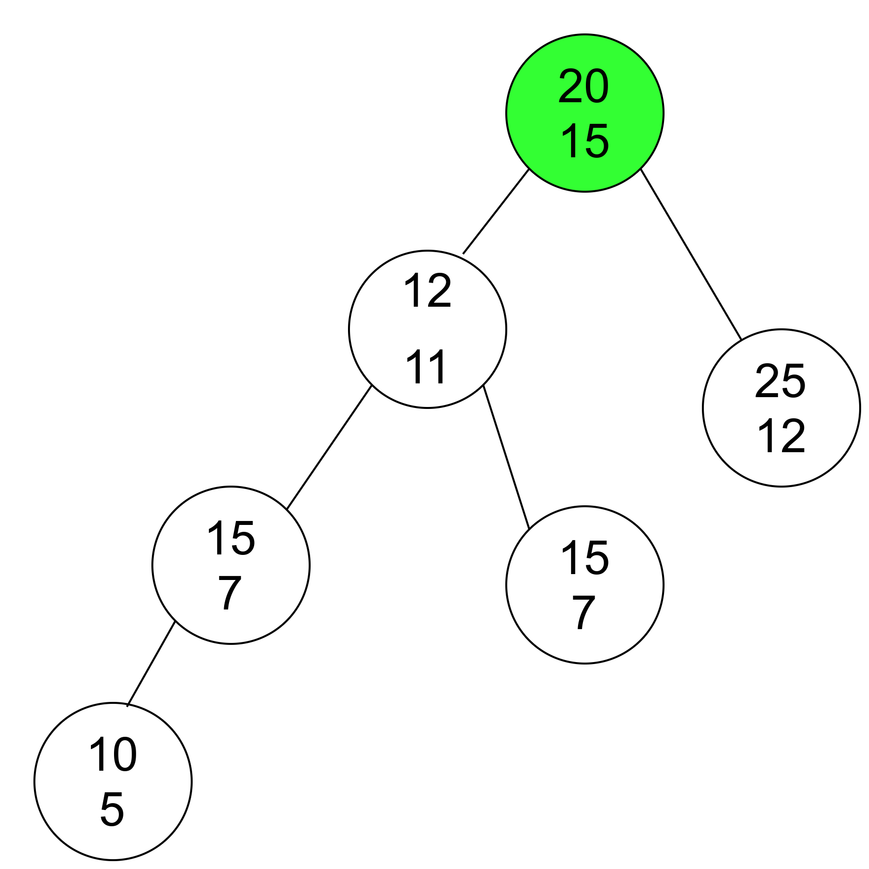
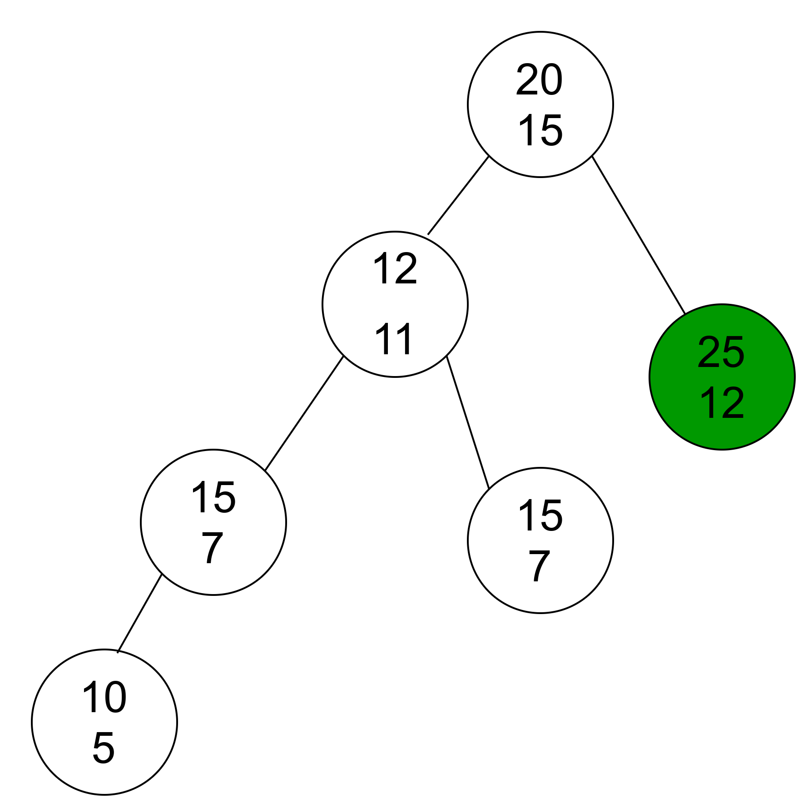
SEARCH 25

Slide 23
Find Minimum
Point to left child till pointer not equals to NULL.

Slide 24
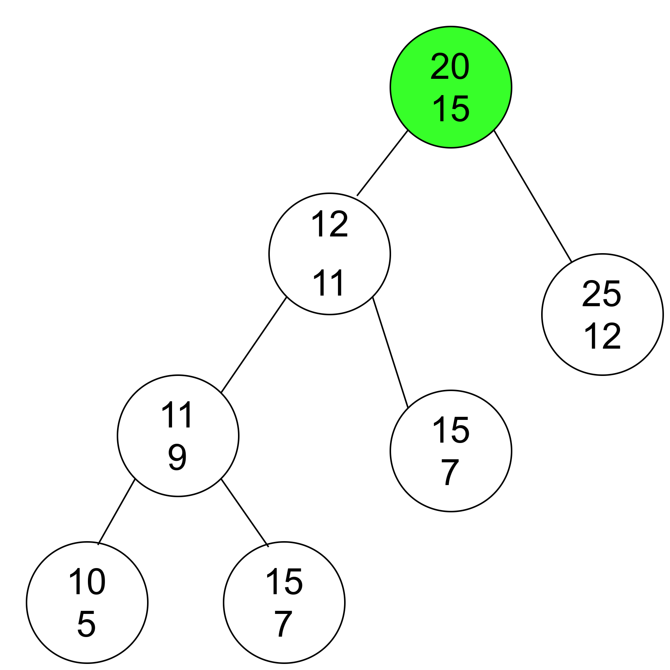
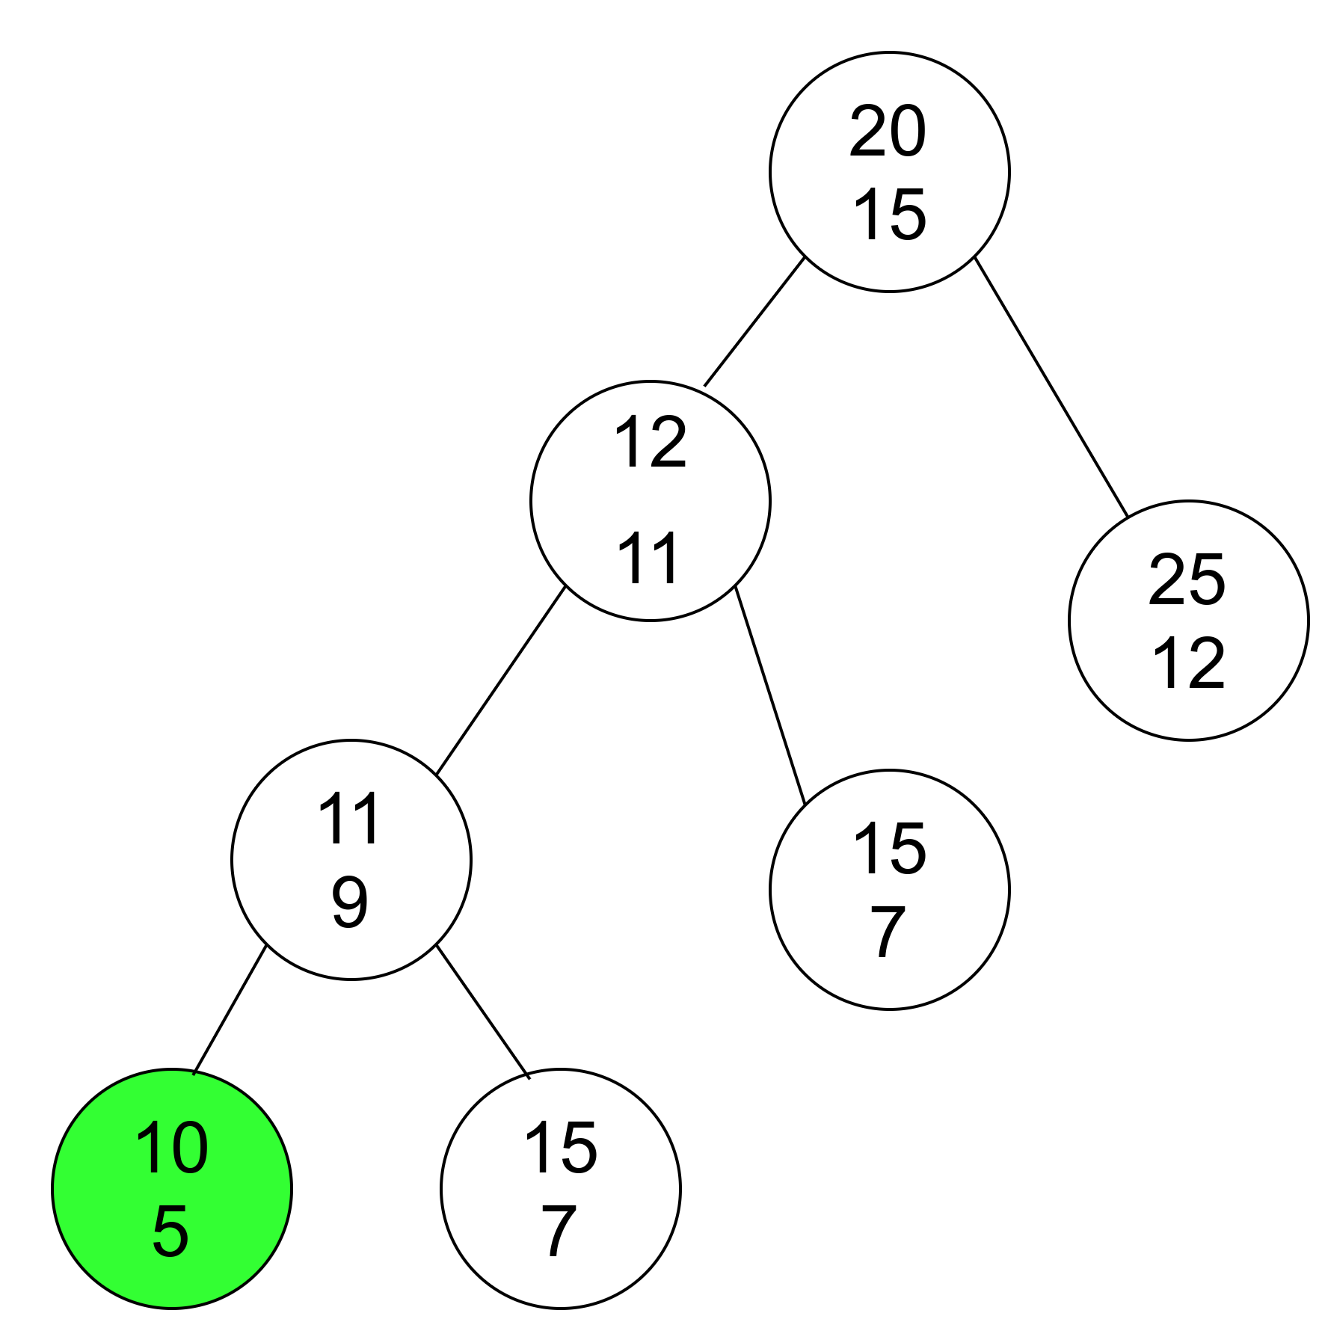
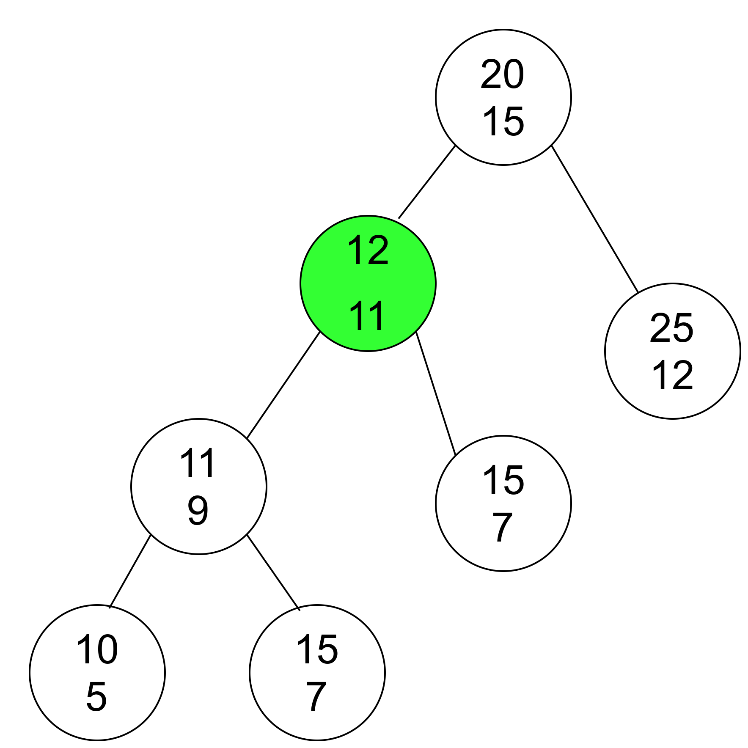
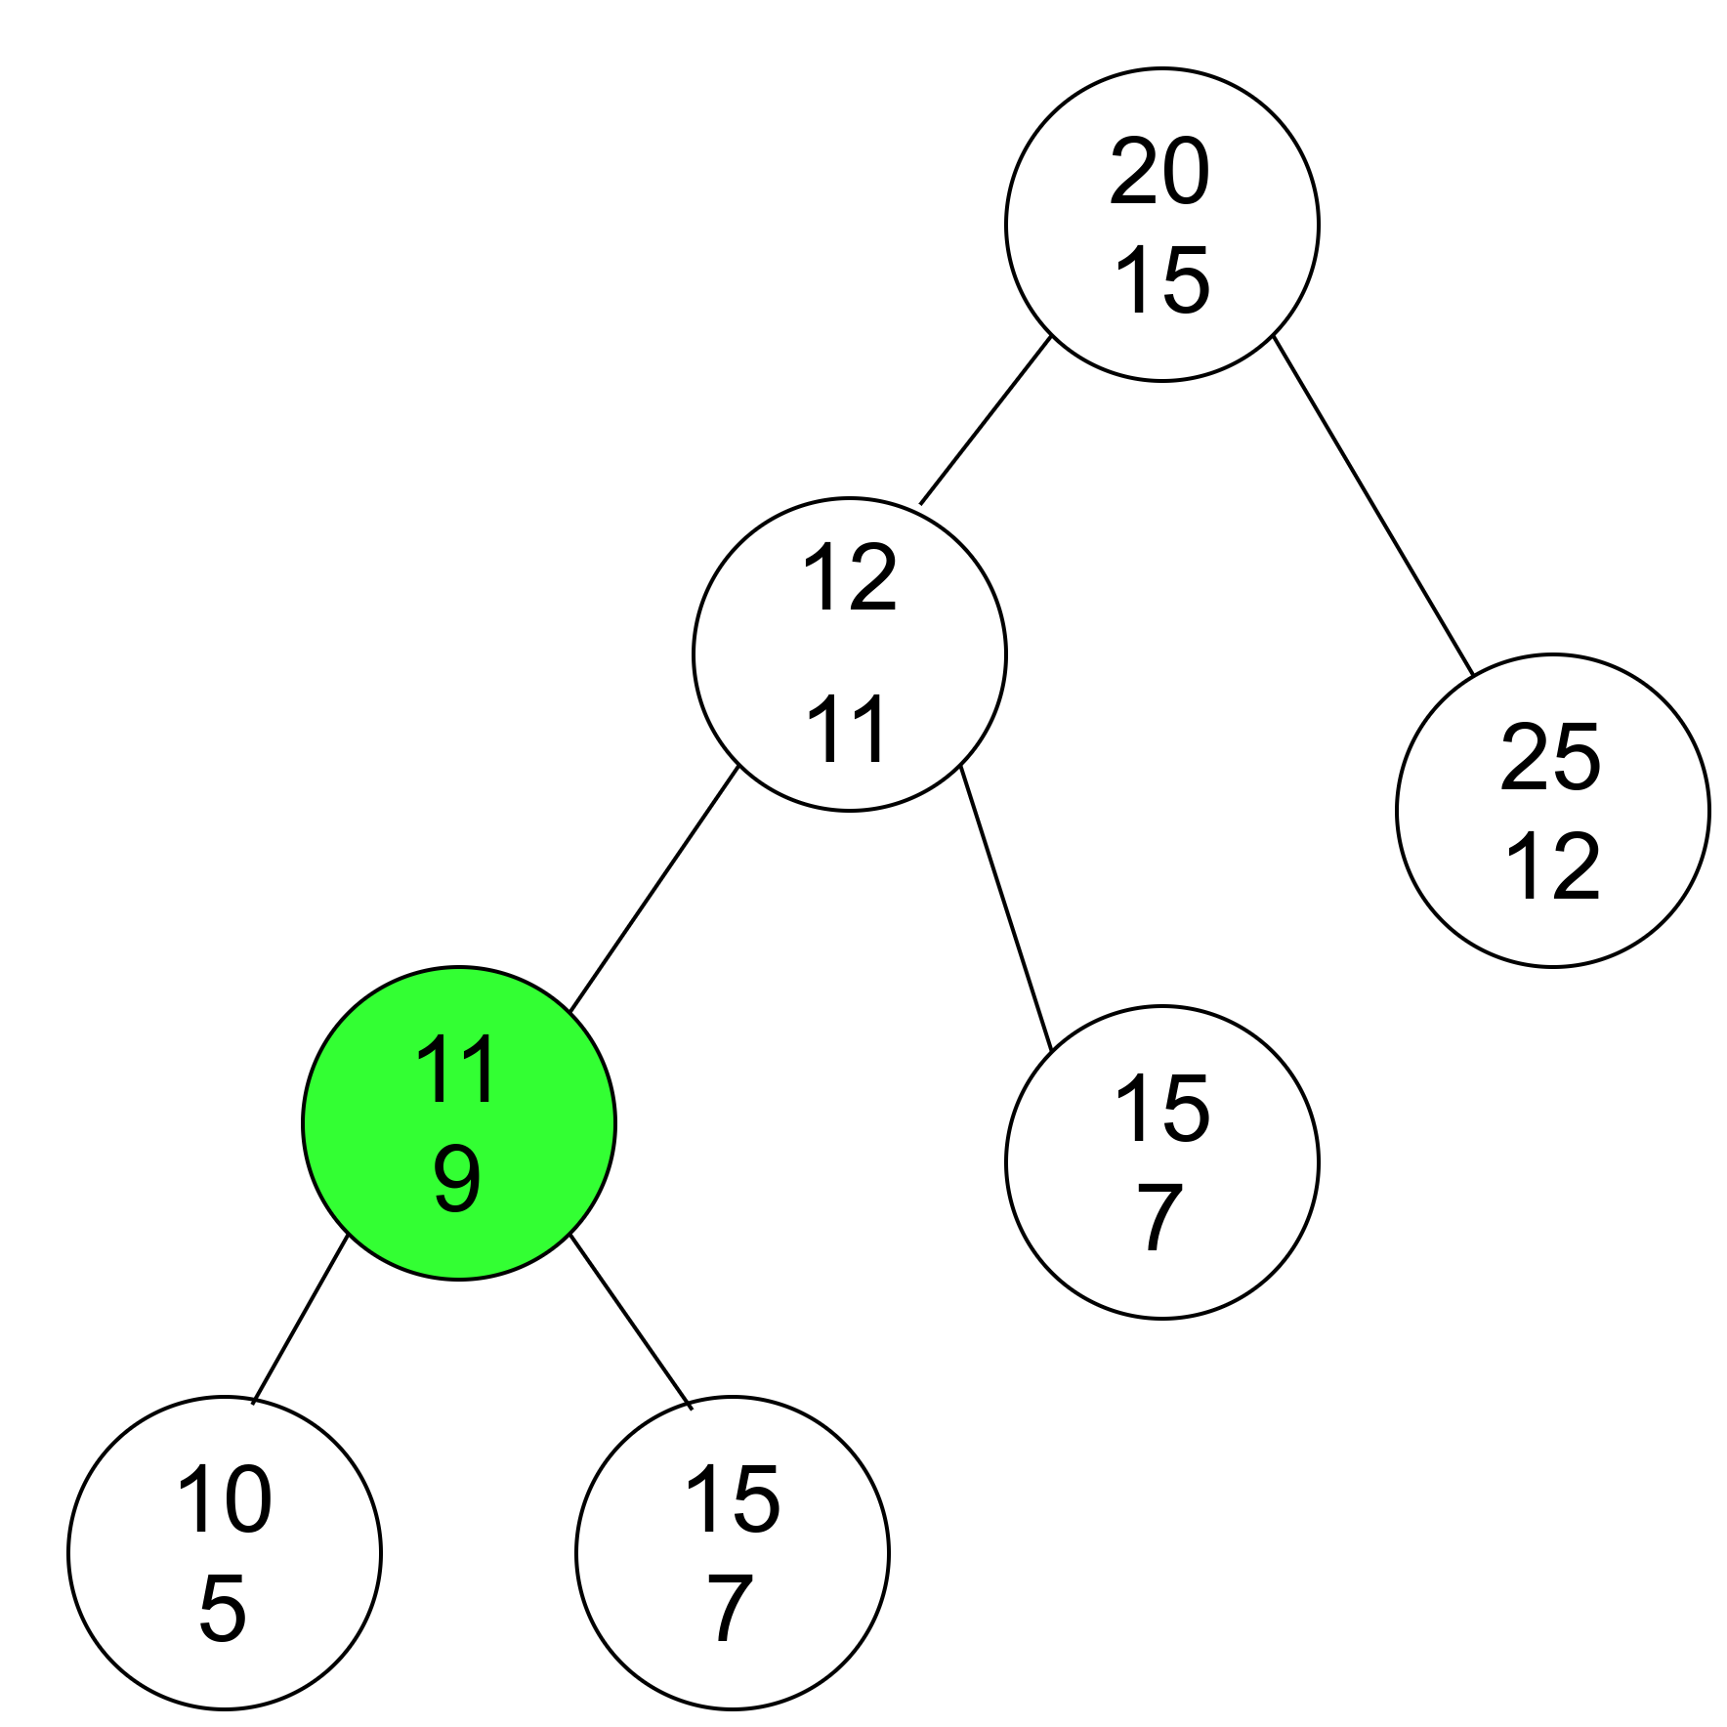

Slide 25
Extarct Minimum
Point to left child till pointer not equals to NULL.
Delete the node if no right child.
If non-null right child exists shift right node to current and delete current.

Slide 26
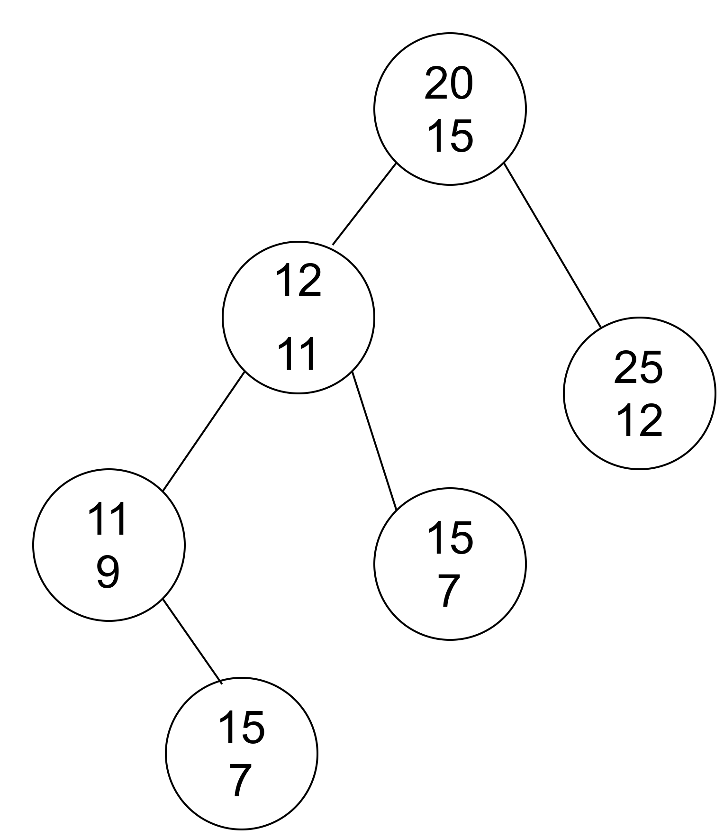

Slide 27
Fibonacci Heap
Collection of trees with min-heap or max-heap property.
Trees can have any shape even all trees can be single nodes.
It always maintain pointer to minimum value.

Slide 28
Fibonacci Heap
12
25
7
11
19
40
22

Slide 29
Insertion
Create a node with given key.
If heap empty, Insert node.
Else Insert node at Minimum->left.
If less than minimum key, update minimum as left of minimum node.

Slide 30
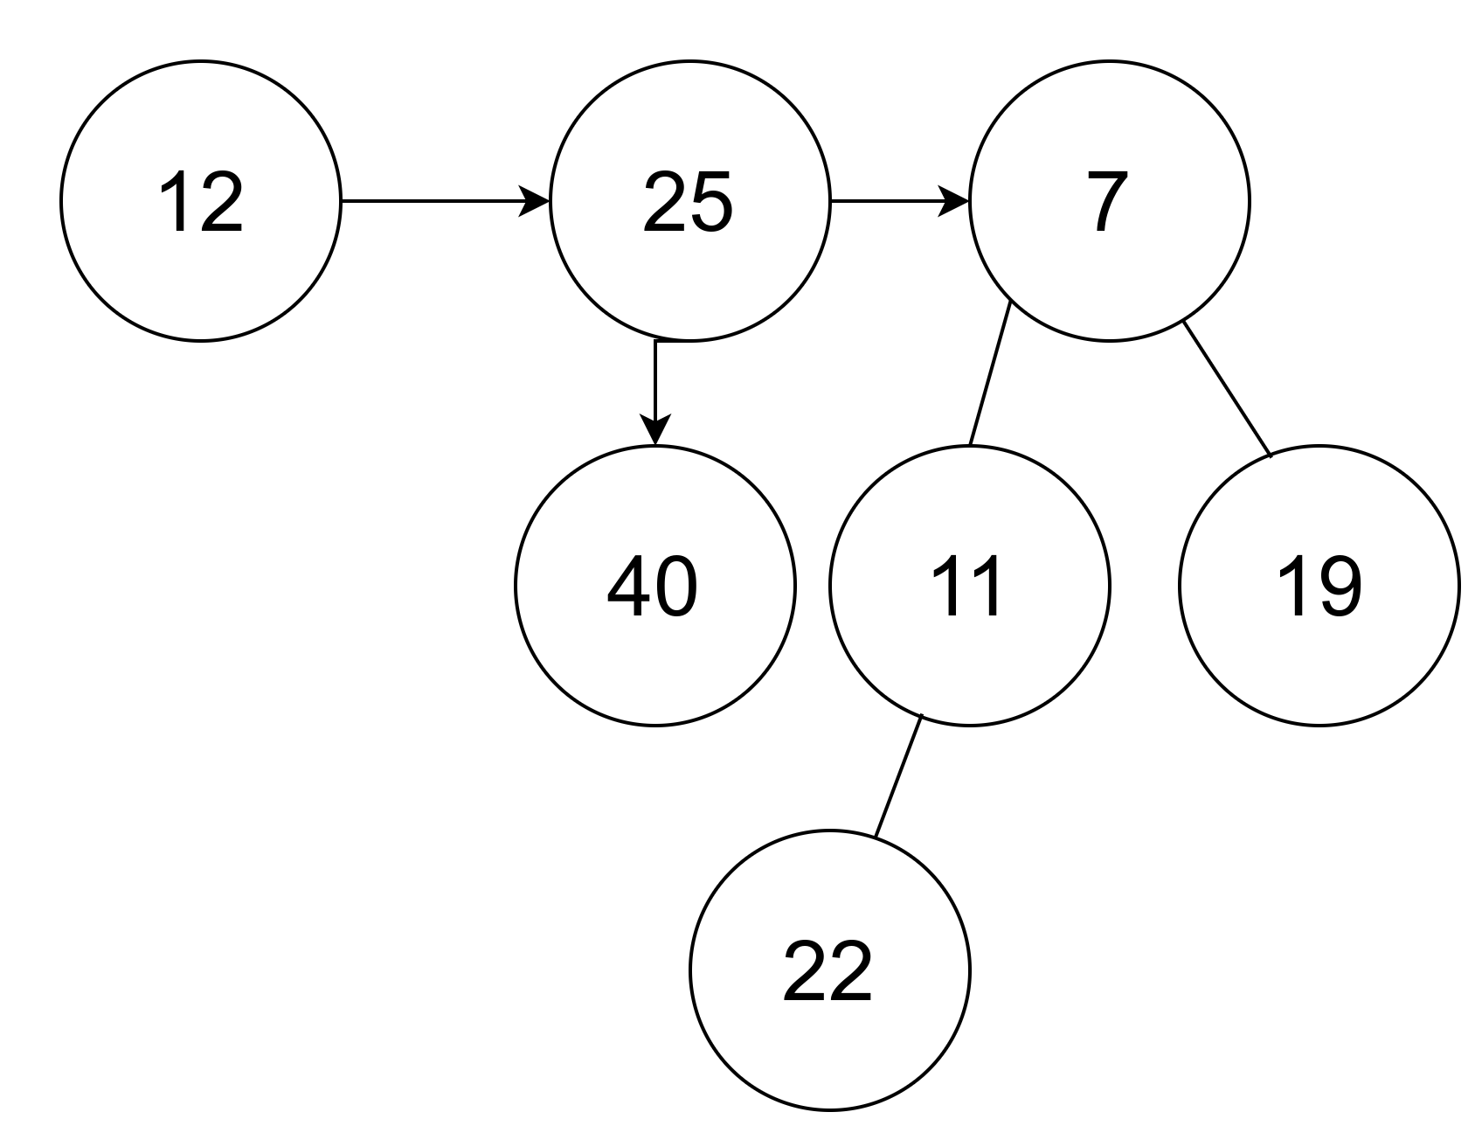
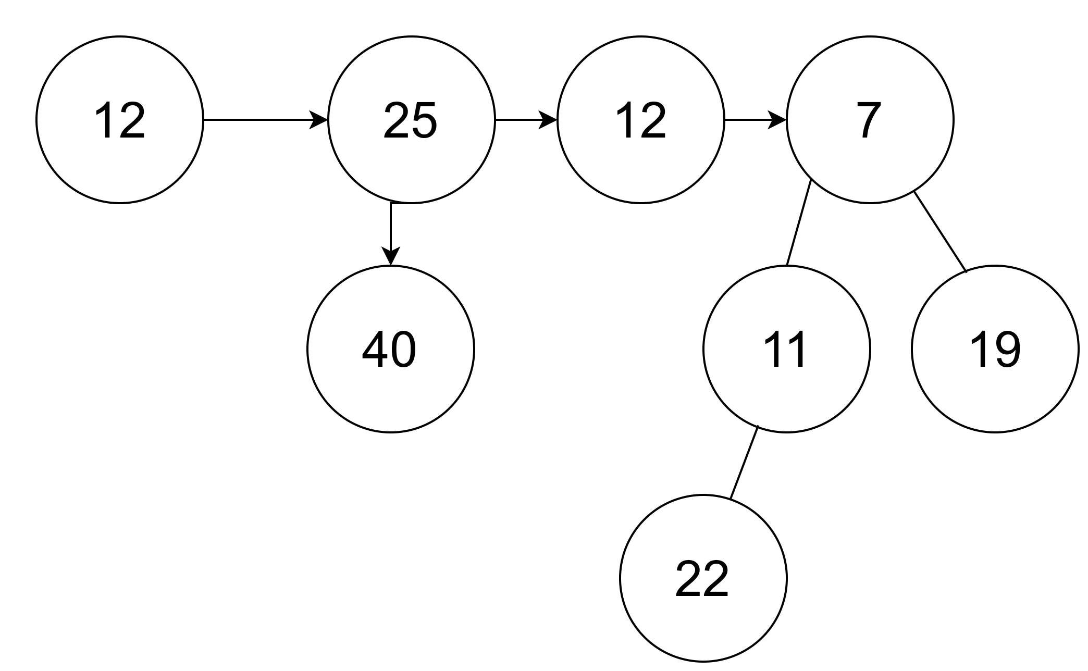
INSERT 12

Slide 31
Deletion
Decrease the value of the node to be deleted 'x' to a minimu by decrement operation
By using min-heap property, heapify the heap containing 'x', bringing 'x' to the root list.
Apply, Extract min operation to the fibonacci heap

Slide 32
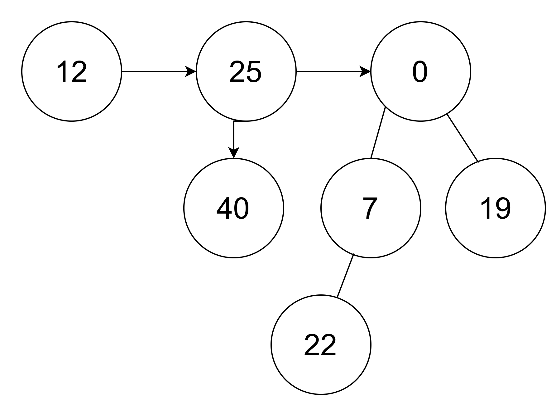
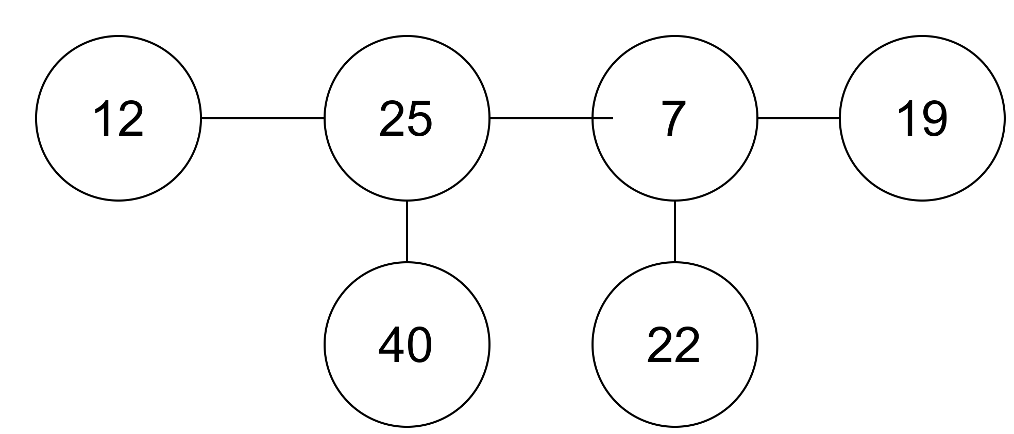
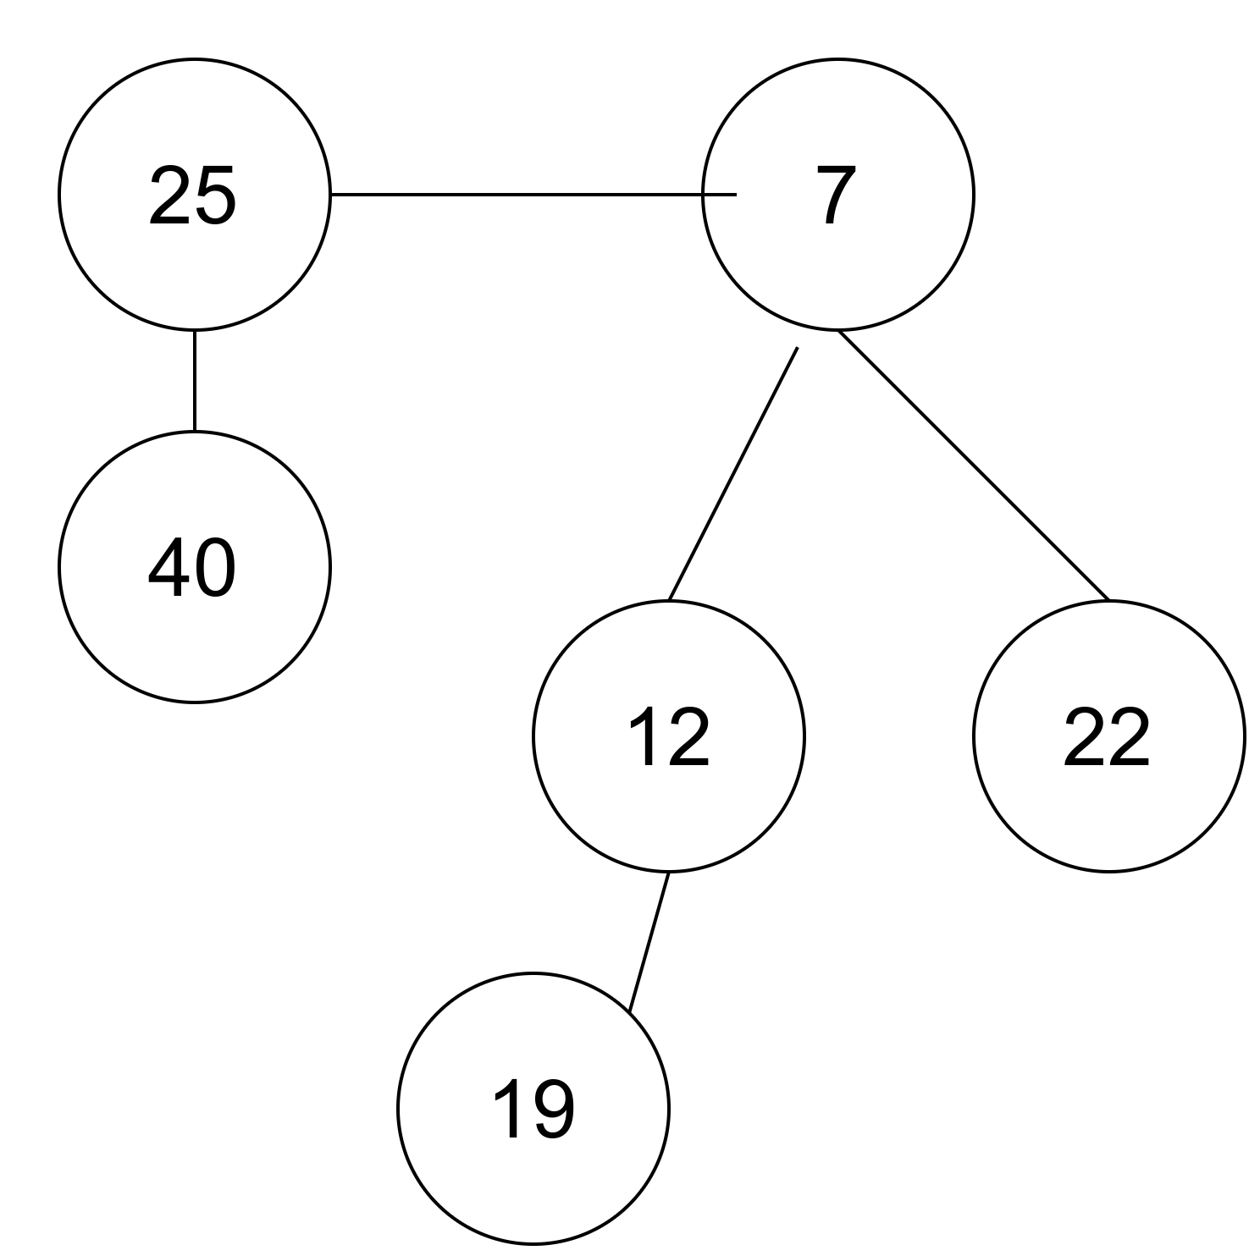
DELETE 11

Slide 33
Decrement Key
Decrease the value of the node 'x' to the new chosen value.
If heap property violated and parent of x is marked, do swap opearations to get heap property. Check If minimum node need to be modified.
Else check if minimum node need to be updated.

Slide 34
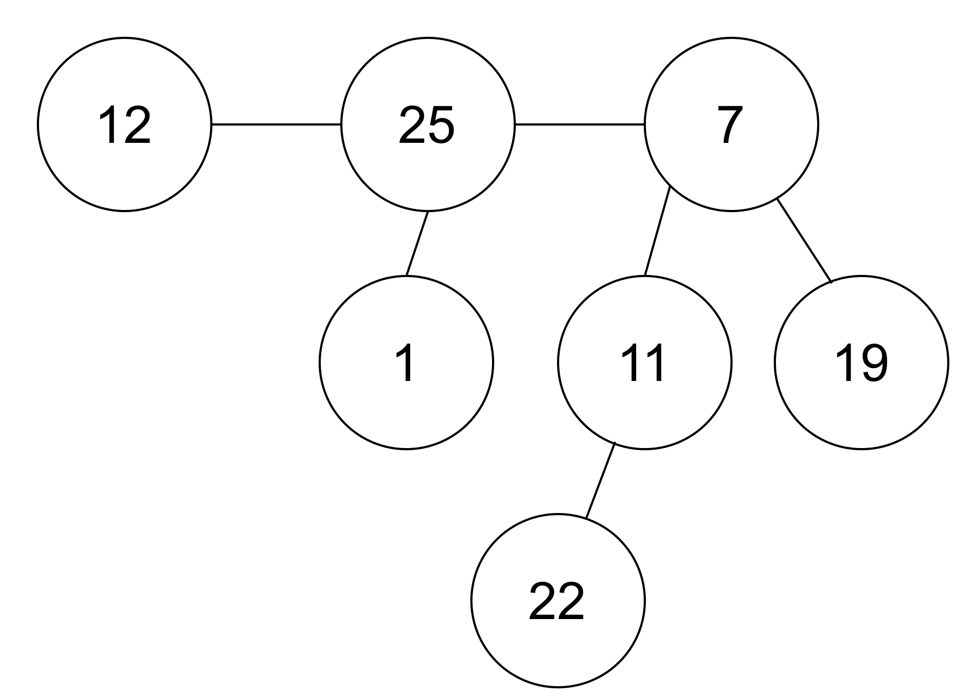
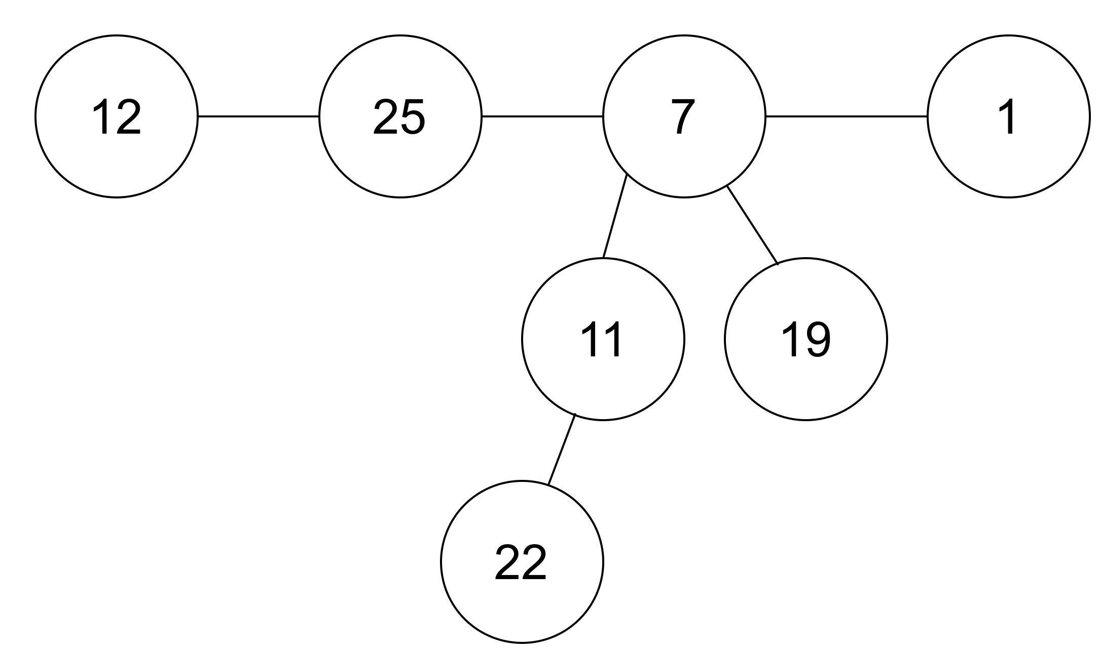
Decrease value 40 to 1

Slide 35
Find Minimum
Minimum pointer will point to minimum key. Hence return minimum key.

Slide 36
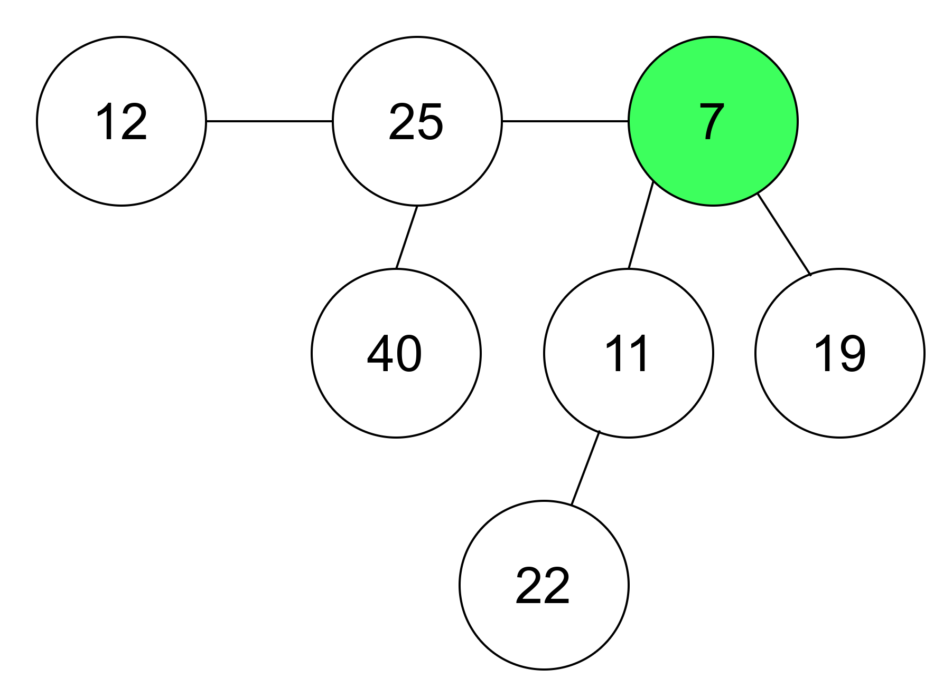

Slide 37
Extract Minimum
Delete the min node
Set head to the min node add all trees under deleted minimum to root list
Set degree pointer to the current node
Move to the next node, if degress are different, pass to next node. Else join them.
Epeat step 4 until heap is completed.

Slide 38
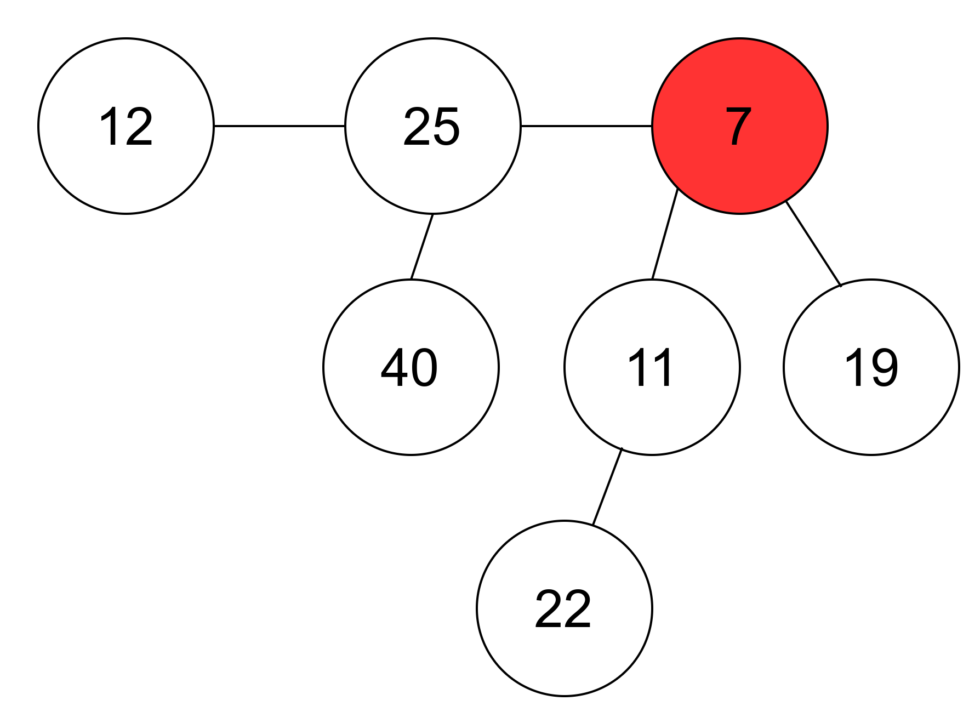
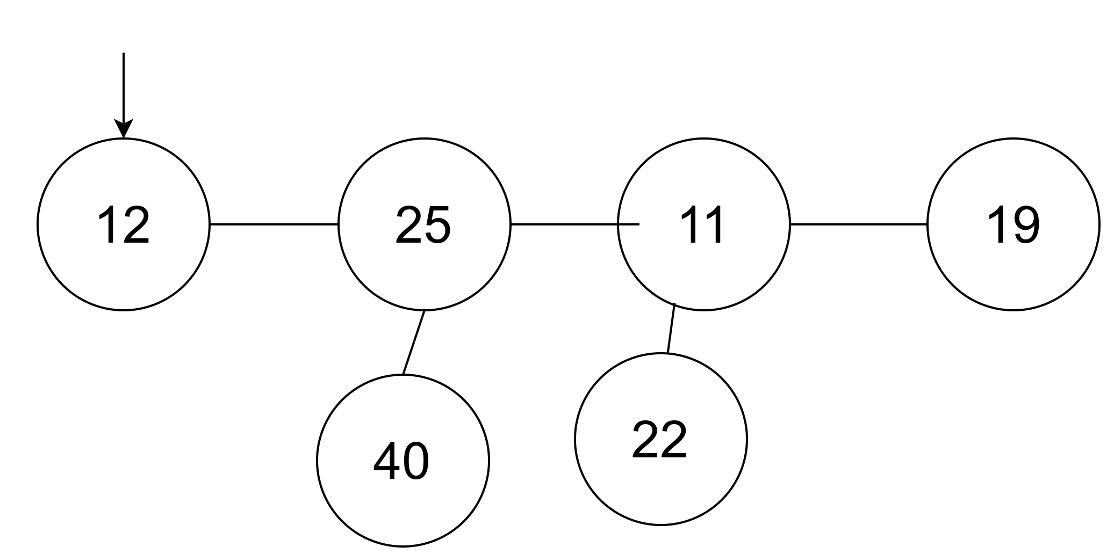
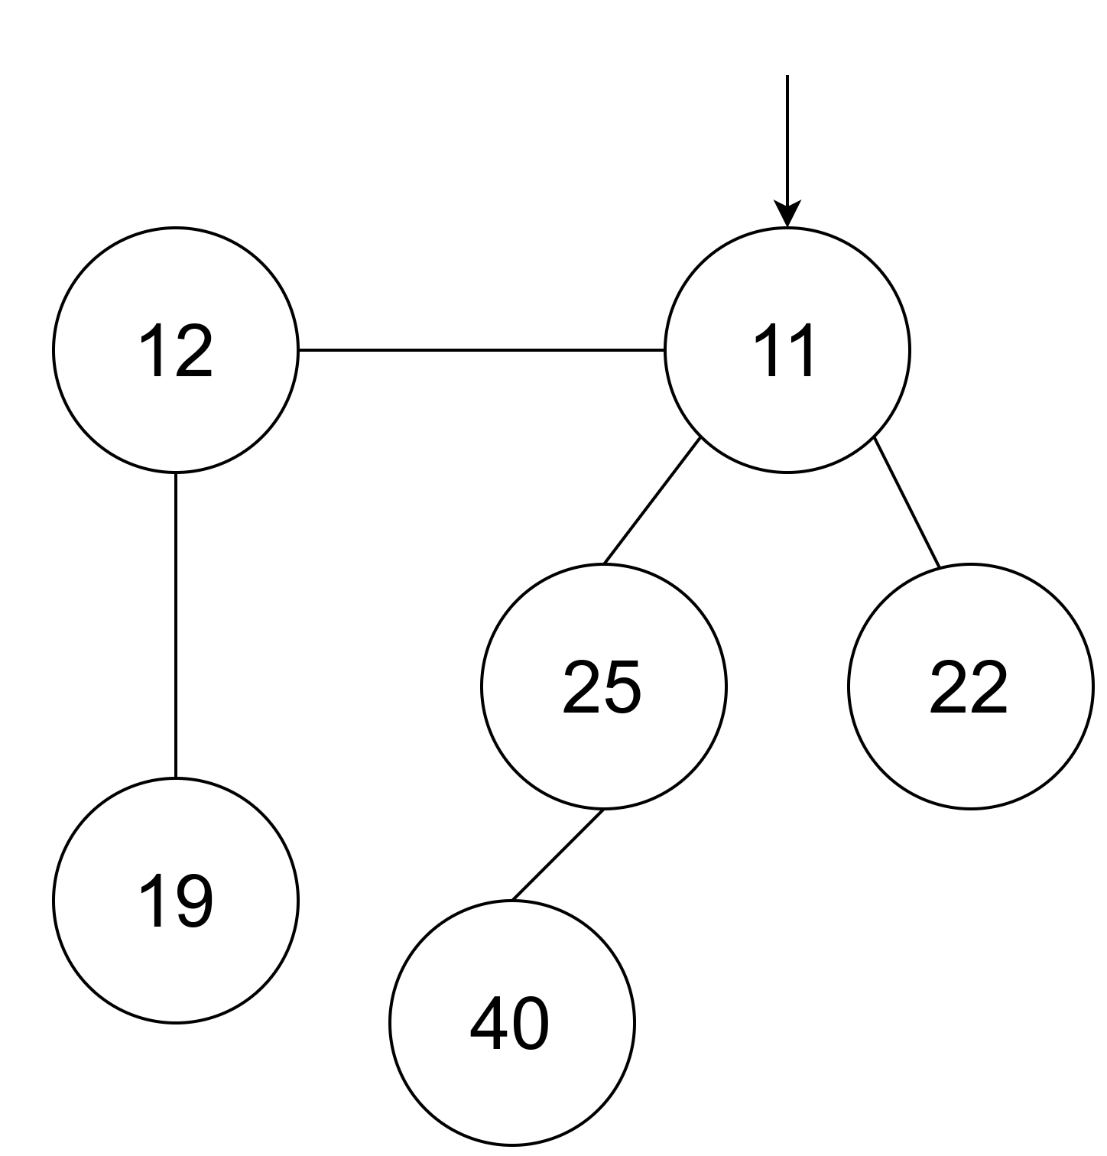
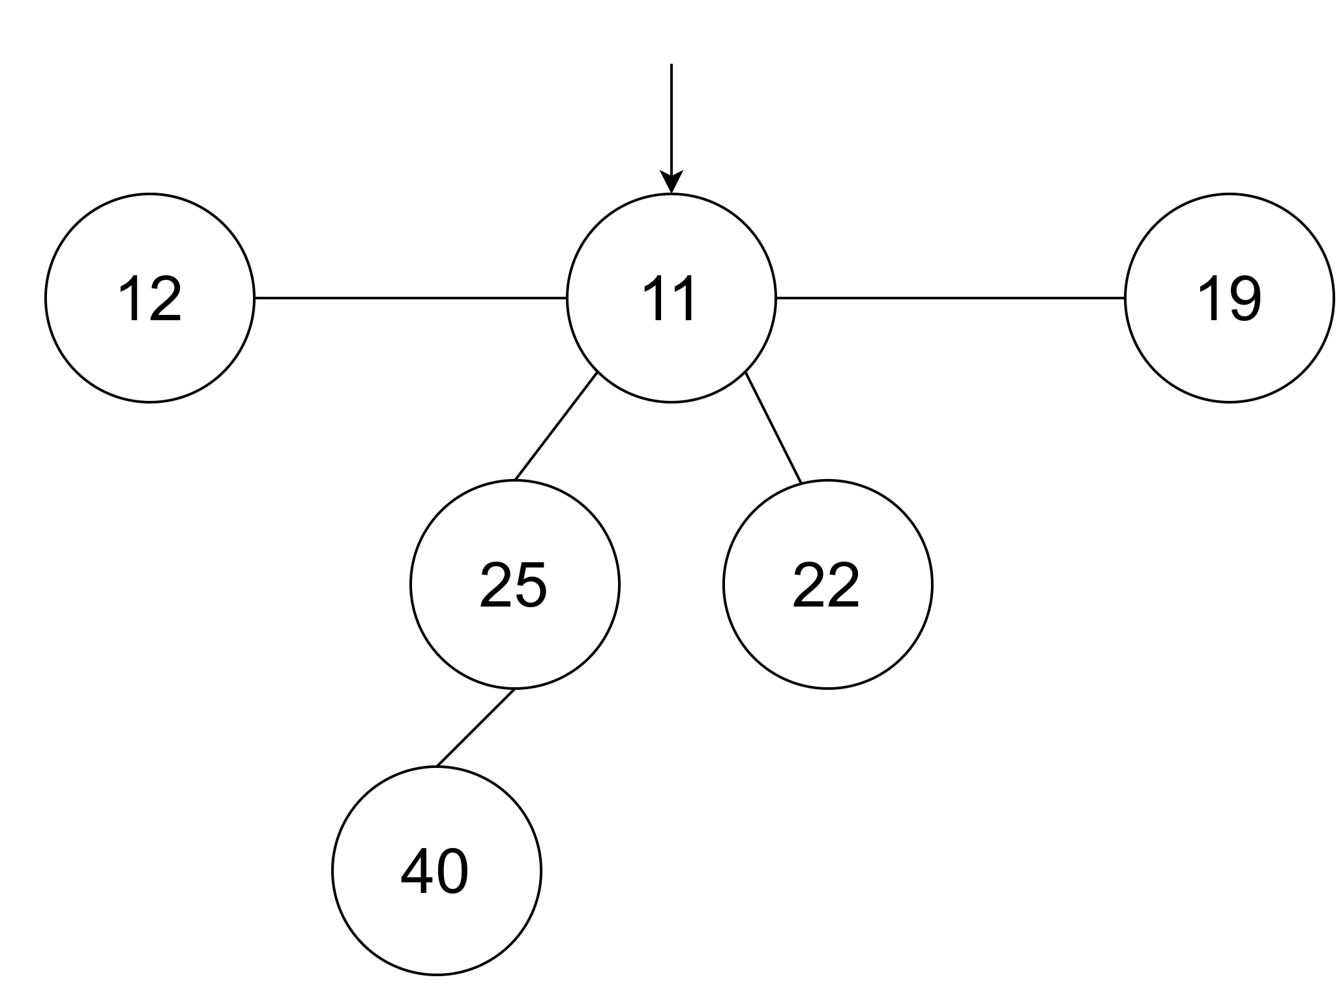

Slide 39
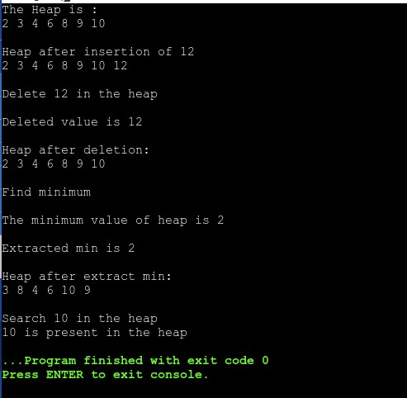
K-ARY HEAP OUTPUT

Slide 40
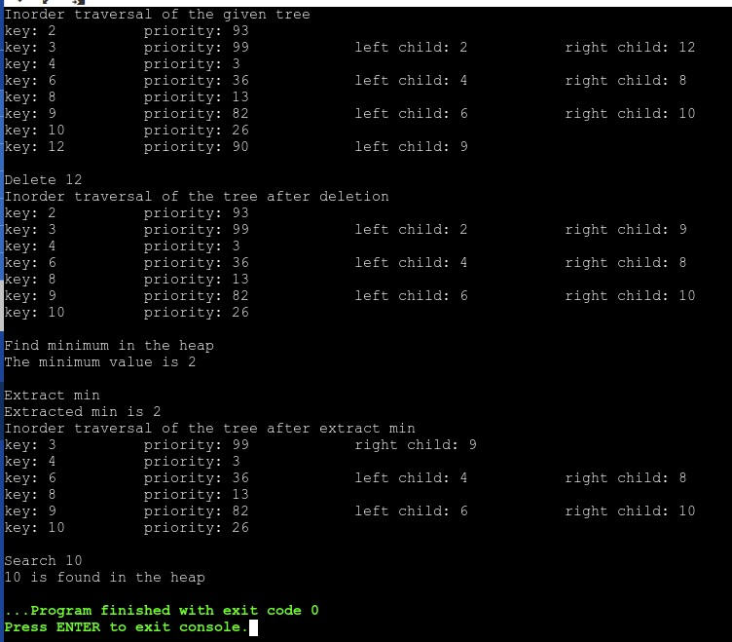
TREAP OUTPUT

Slide 41
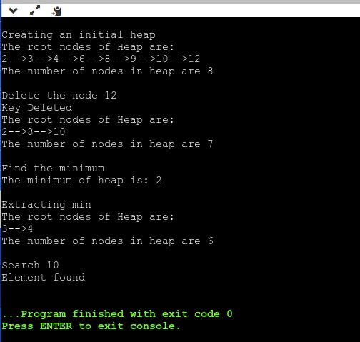
FIBONACCI HEAP OUTPUT

Slide 42


